Slide 1
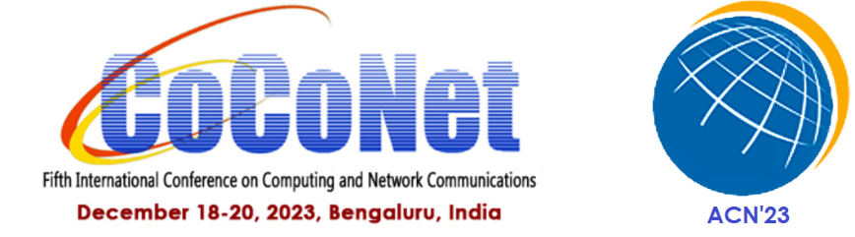
Emerging Trends in Quantum Computing And Cryptography
Rohan C
Lightning Talk

Slide 2
Outline
Existing Motivation
Cryptography and it’s types
RSA Encryption
General Number Field Sieve Algorithm
Quantum Algorithms
Conclusion
Future Work
References

Slide 3

Existing Motivation
Passwords
Bank Details
Government Intelligence
Social Security
Industrial & Pharmaceutical Research
Store Now Decrypt Later - SNDL

Slide 4
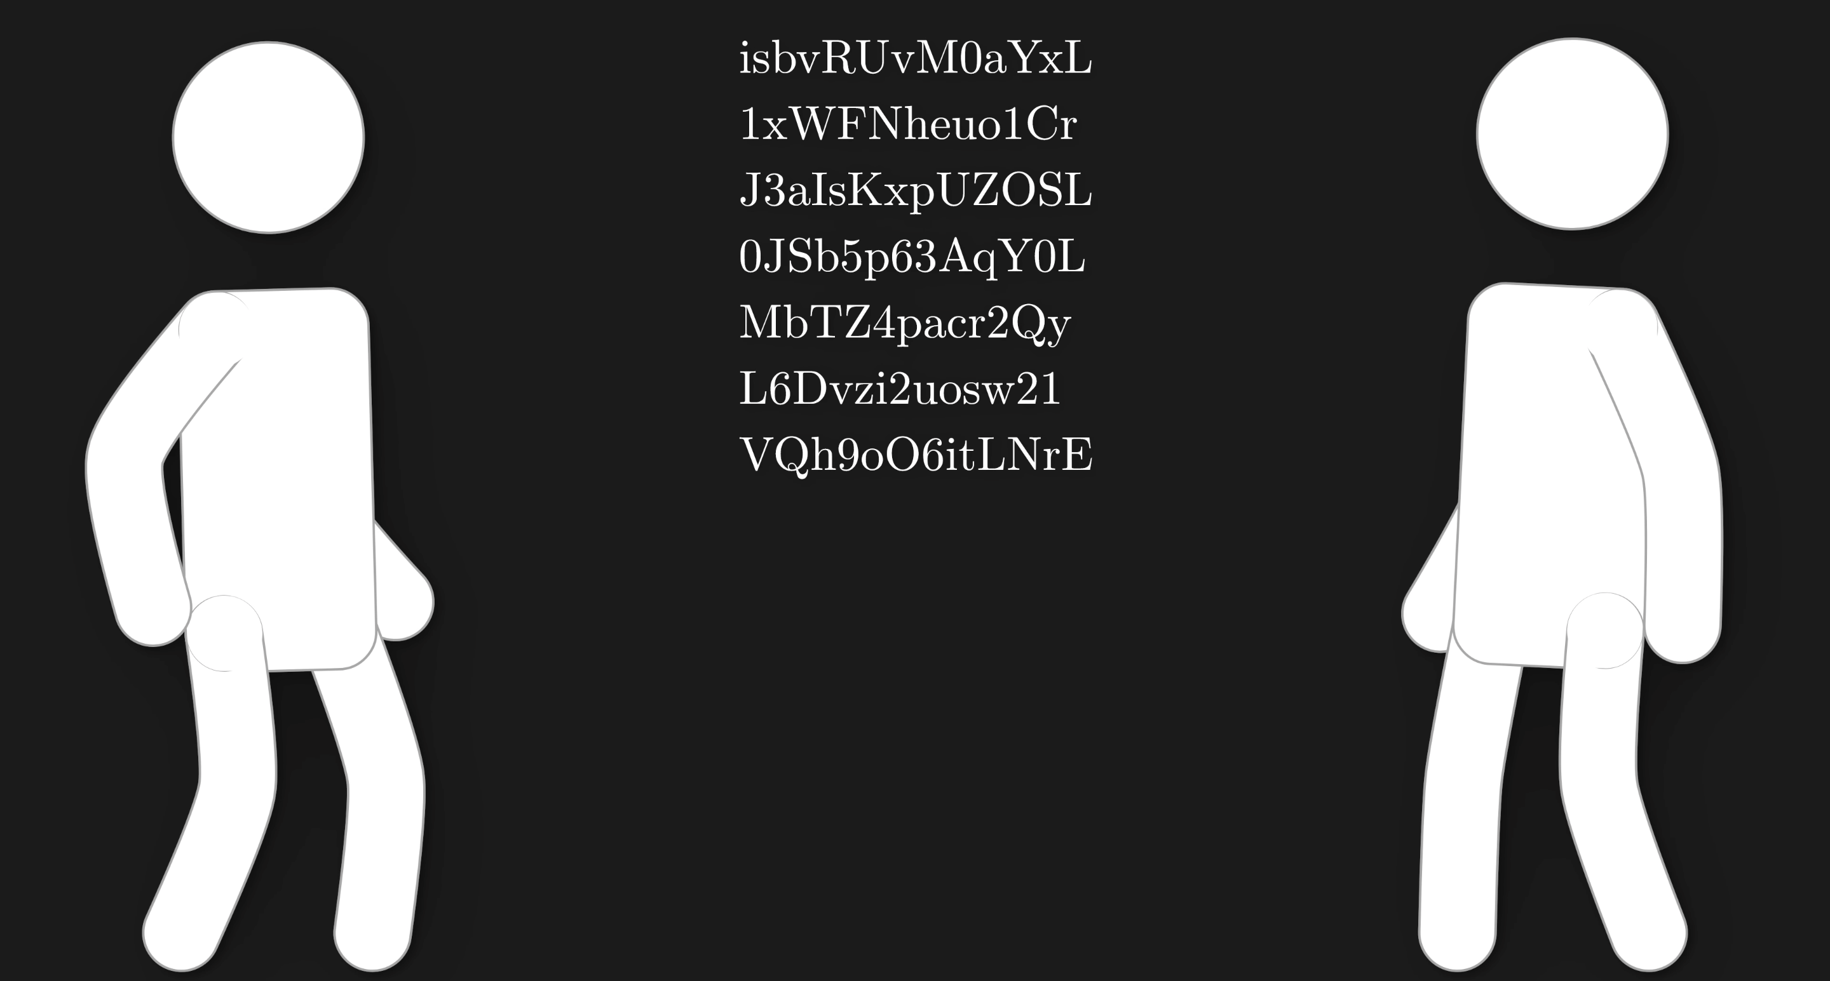
Symmetric-Key Algorithm

Slide 5

Symmetric-Key Algorithm

Slide 6
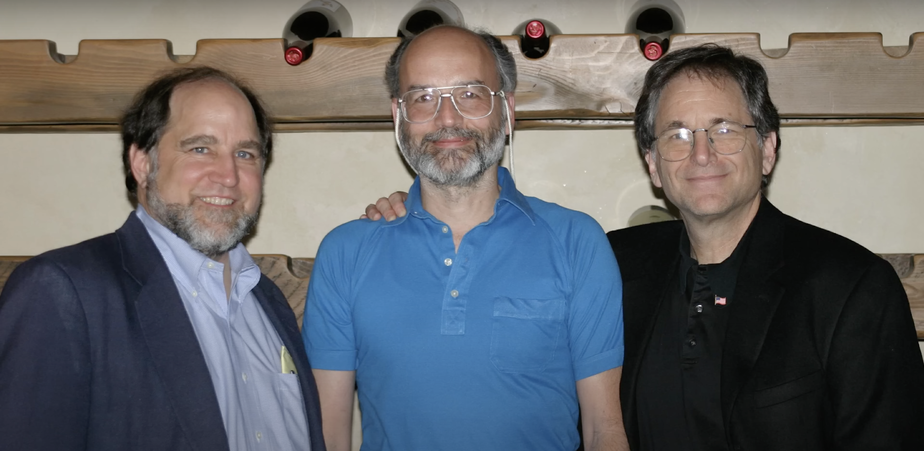
Public Asymmetric-Key Encryption

Slide 7
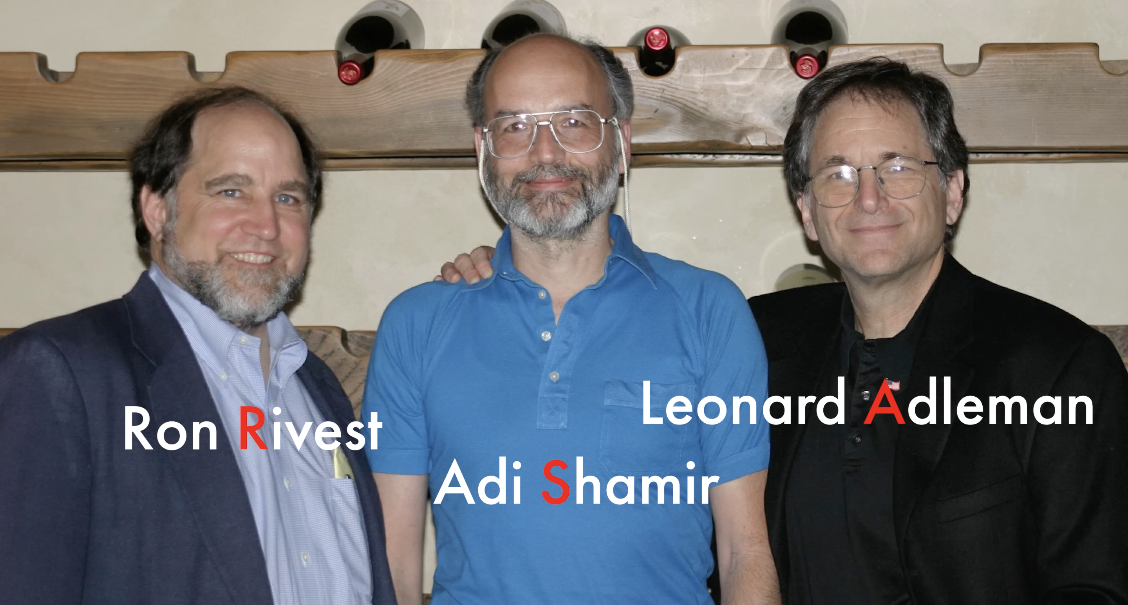
Public Asymmetric-Key Encryption

Slide 8

RSA Encryption

Slide 9
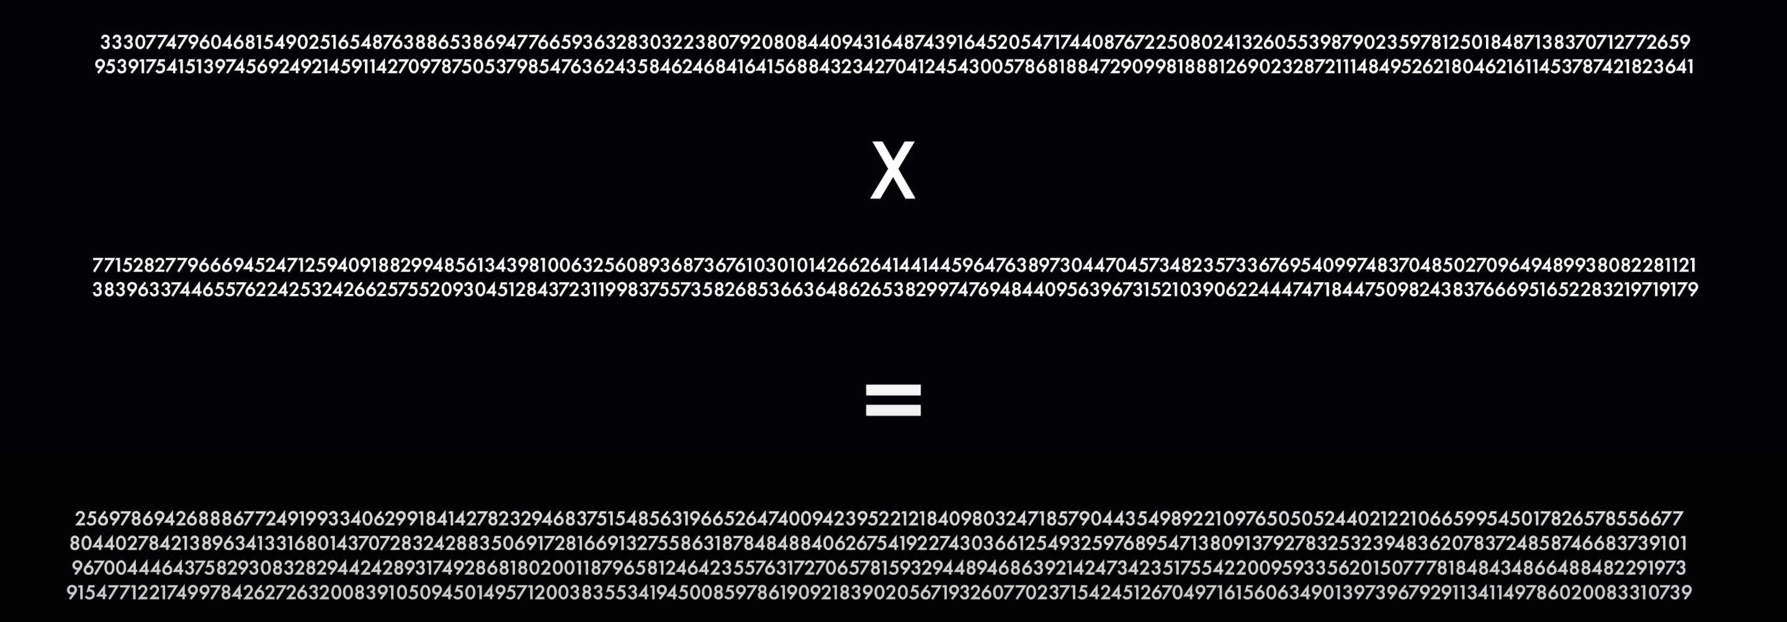
RSA Encryption-Factoring
300 Digits LONG!!
Takes 16 Million Years for modern-day SUPERCOMPUTER

Slide 10
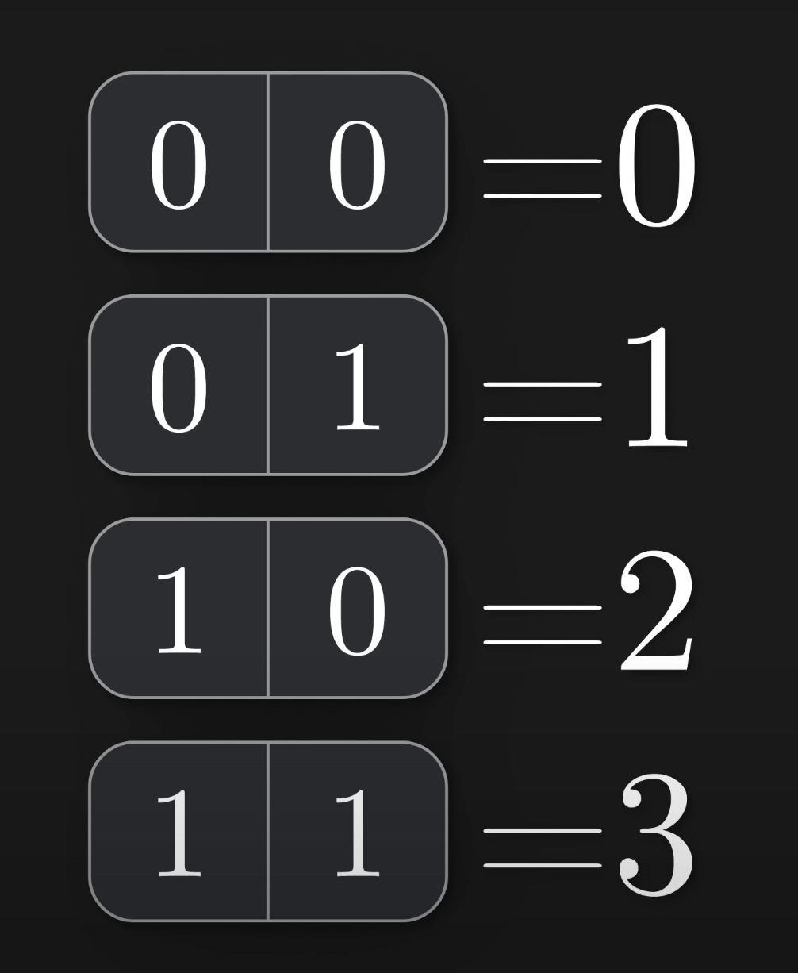
Classical Bits

Slide 11
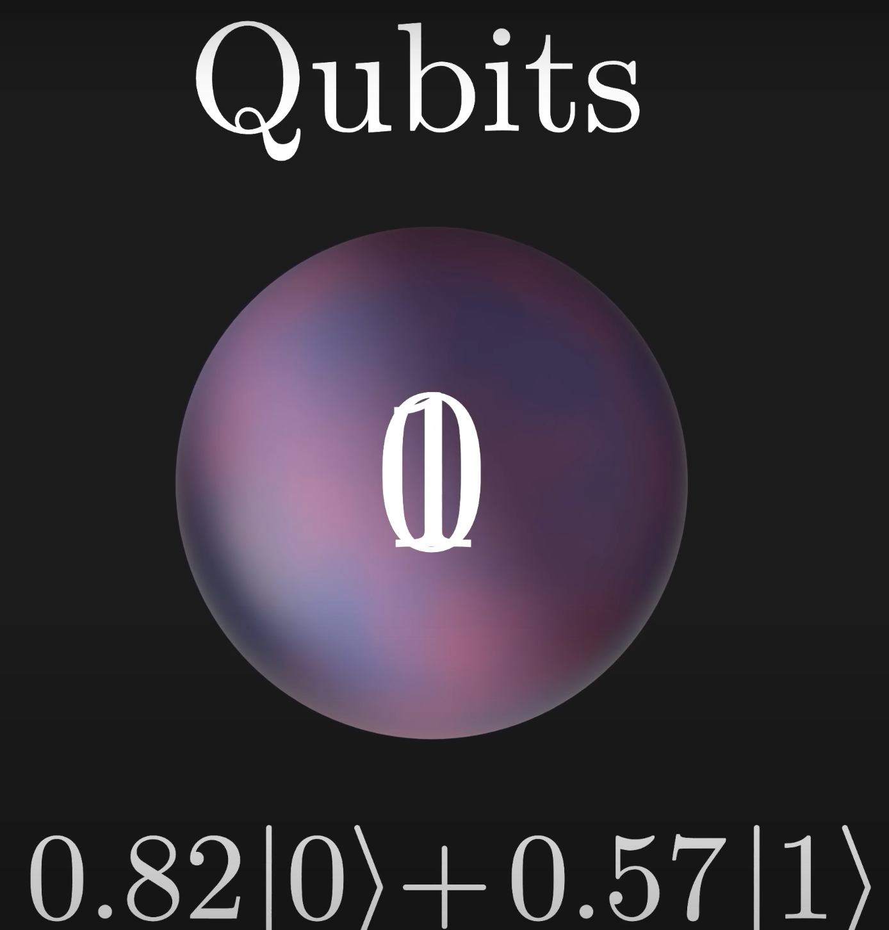
Quantum Bits - Qubits

Slide 12
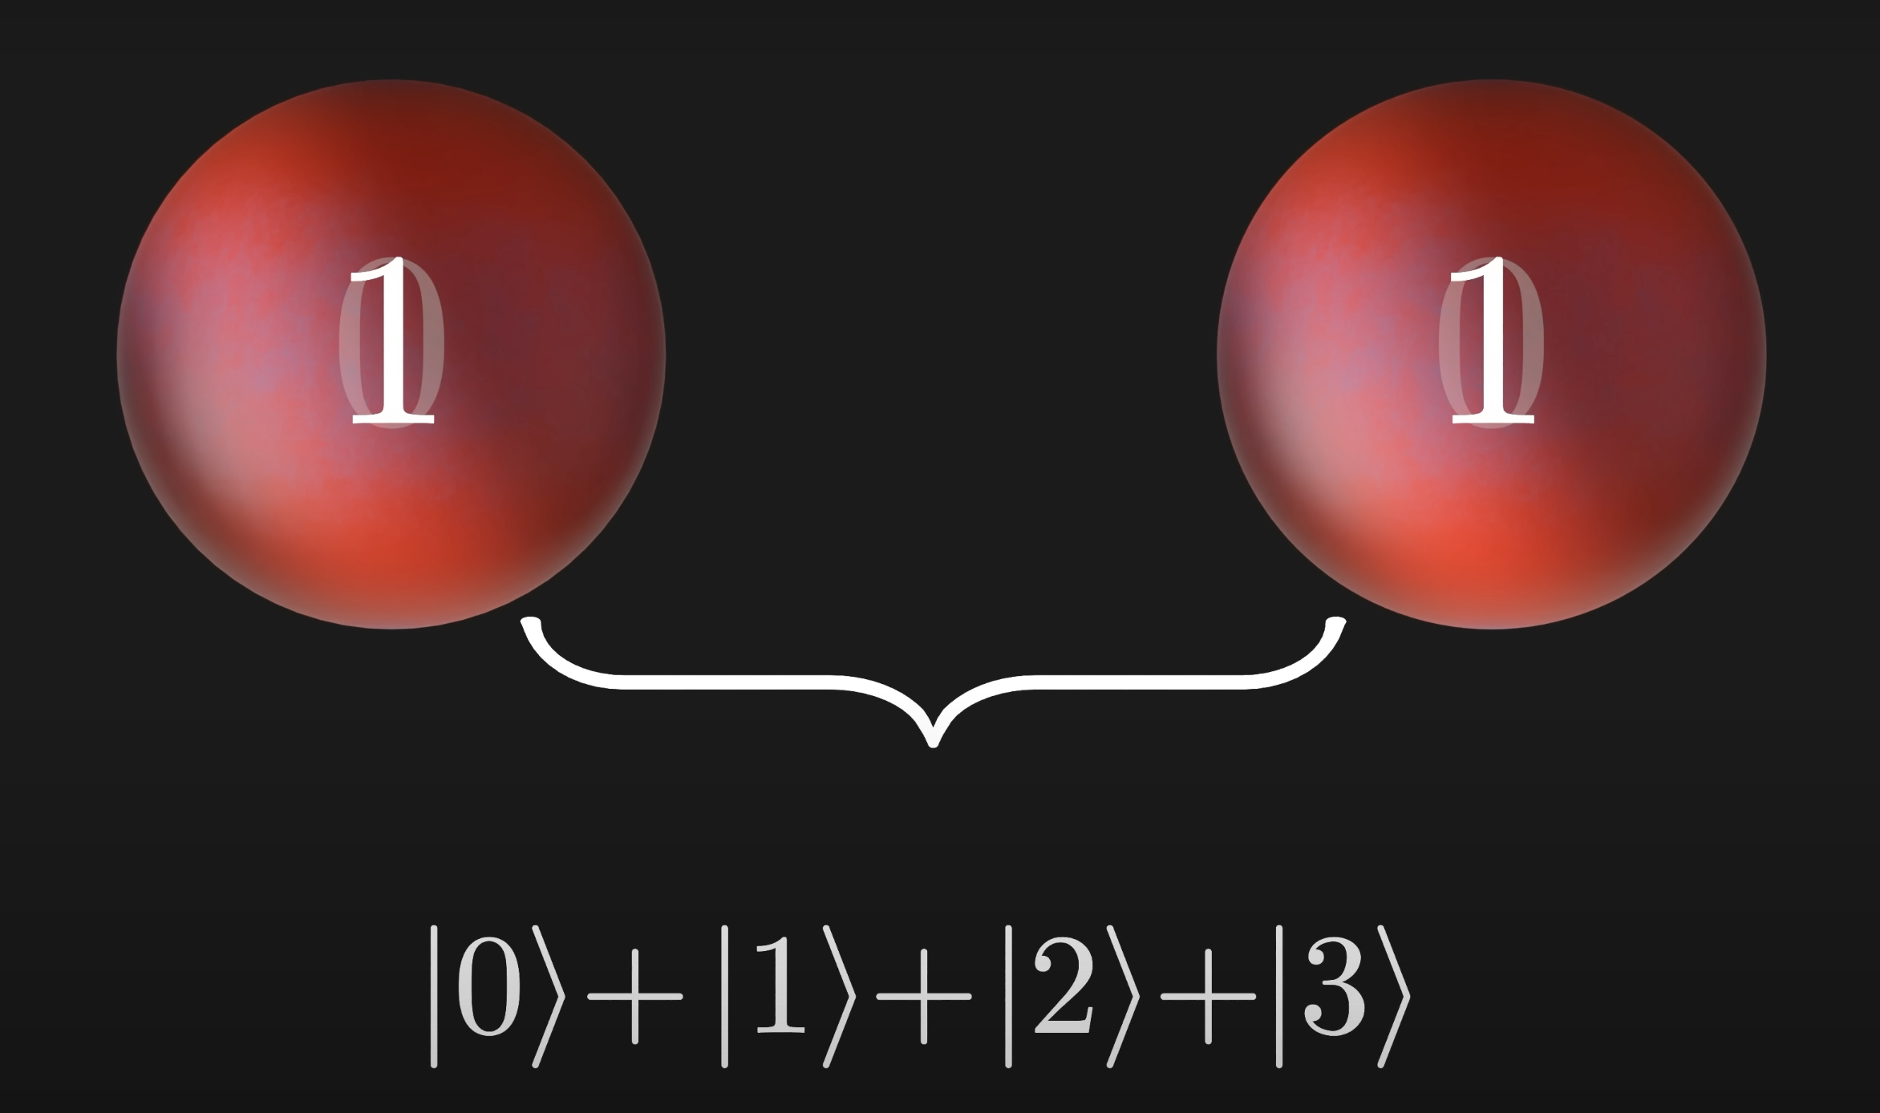
Superposition

Slide 13
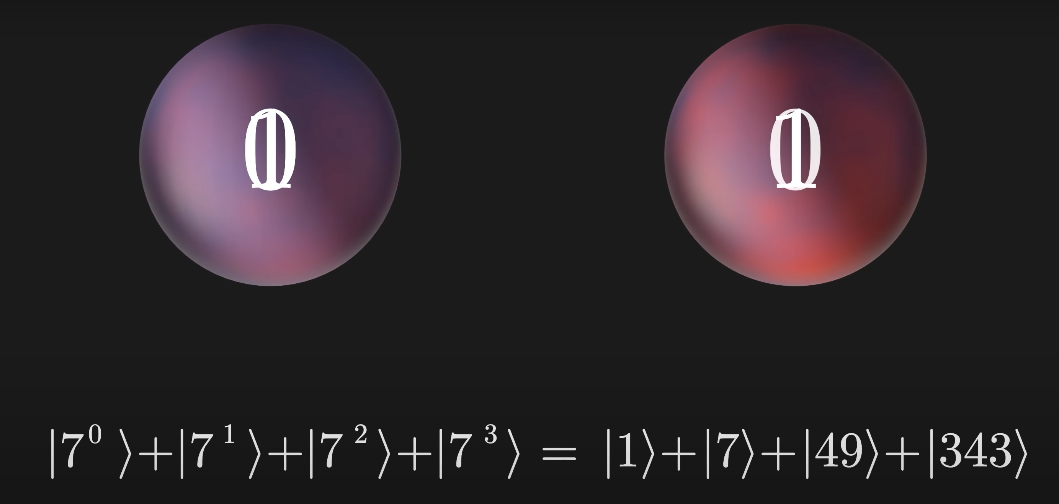
Superposition

Slide 14
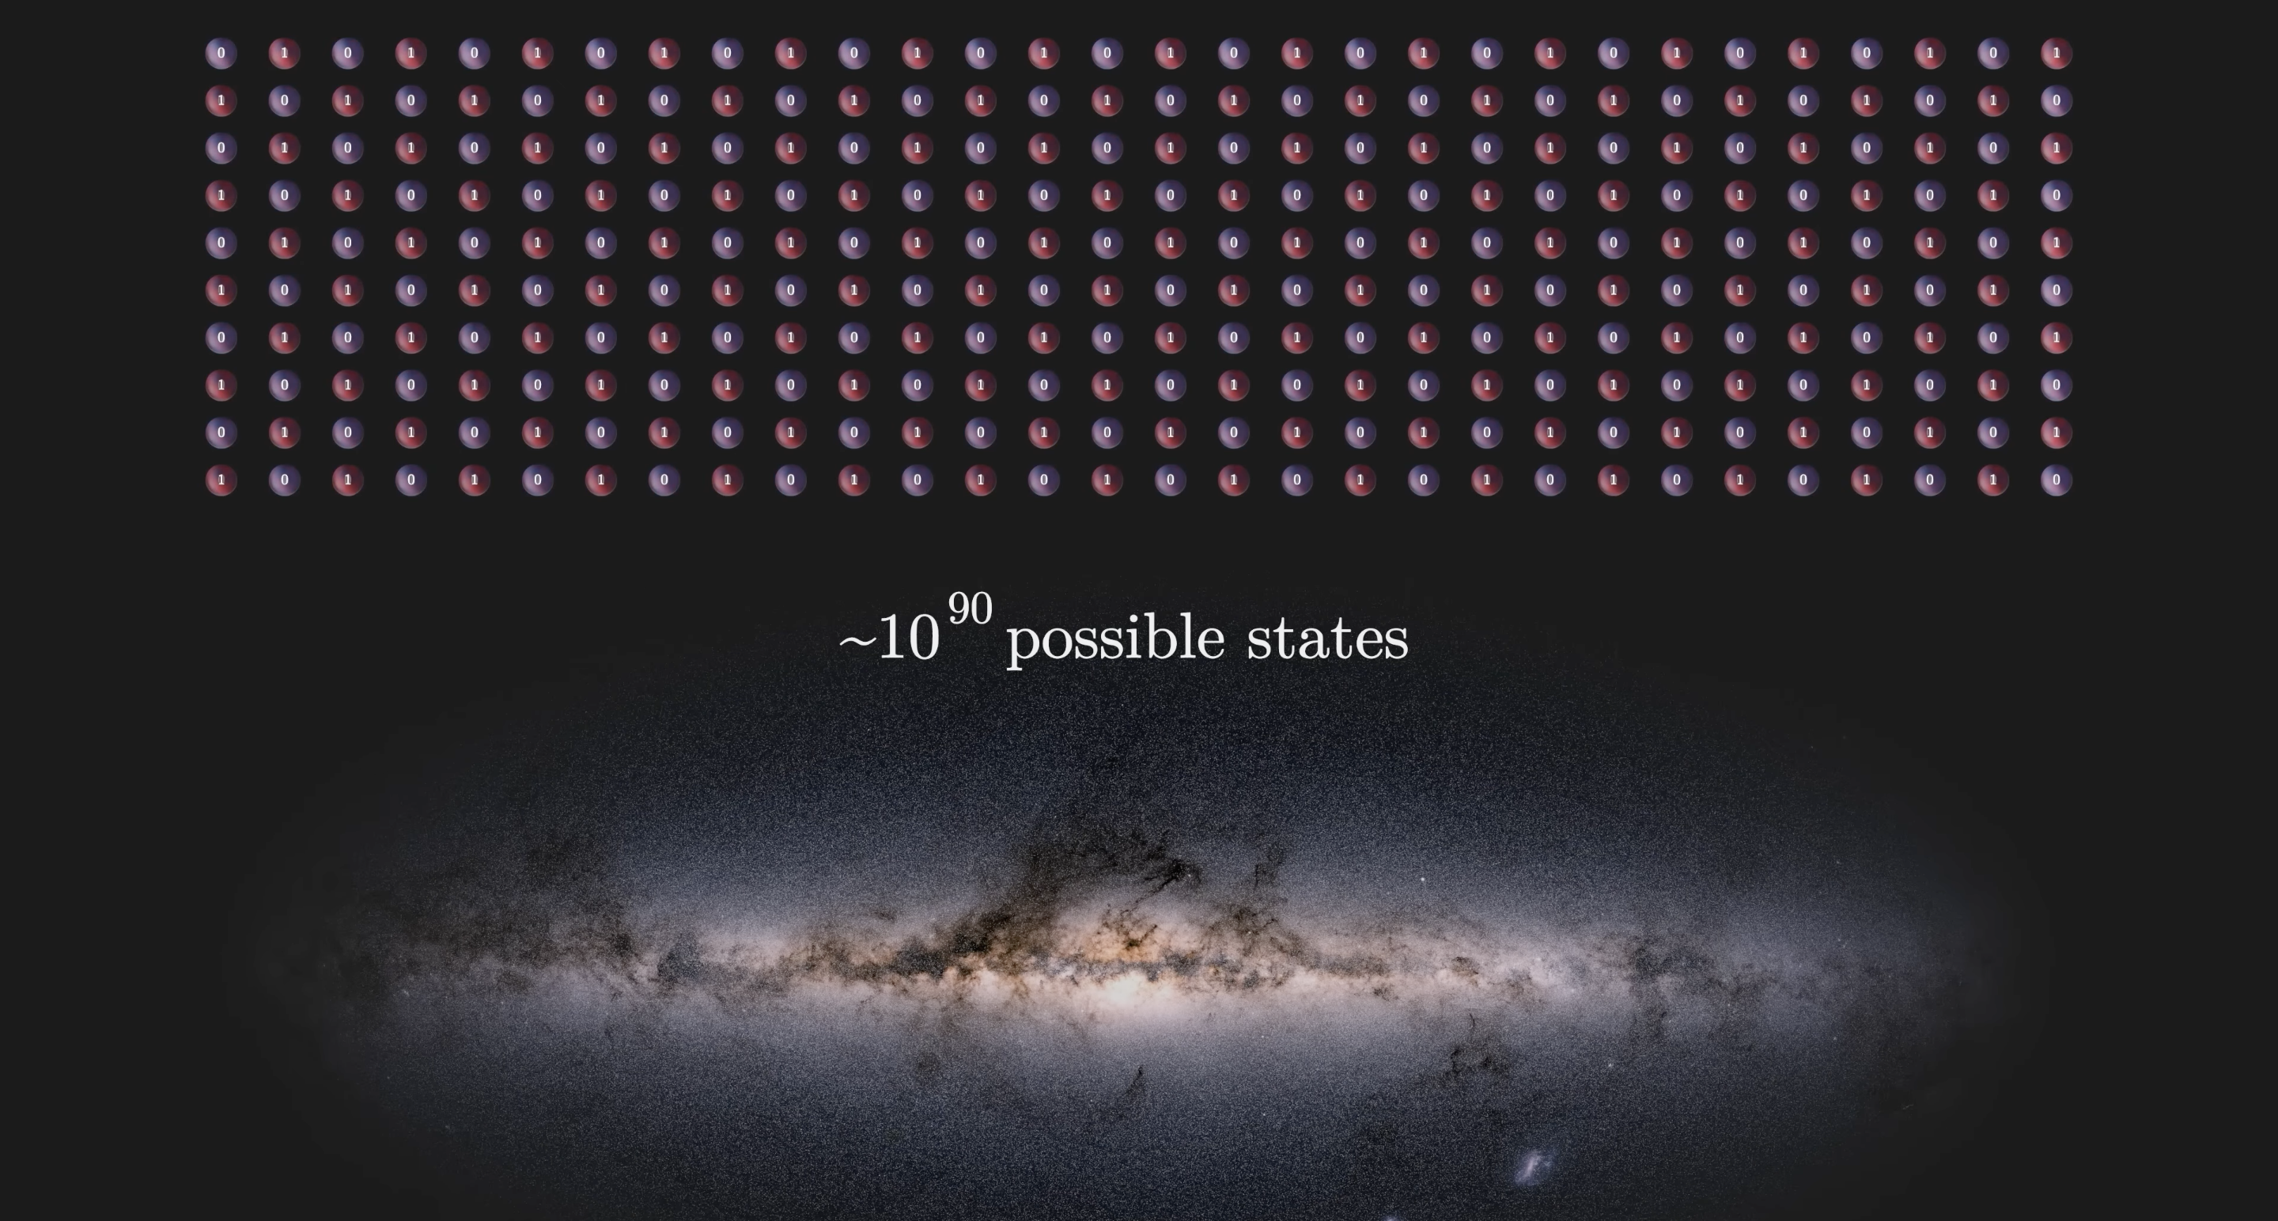
Superposition

Slide 15
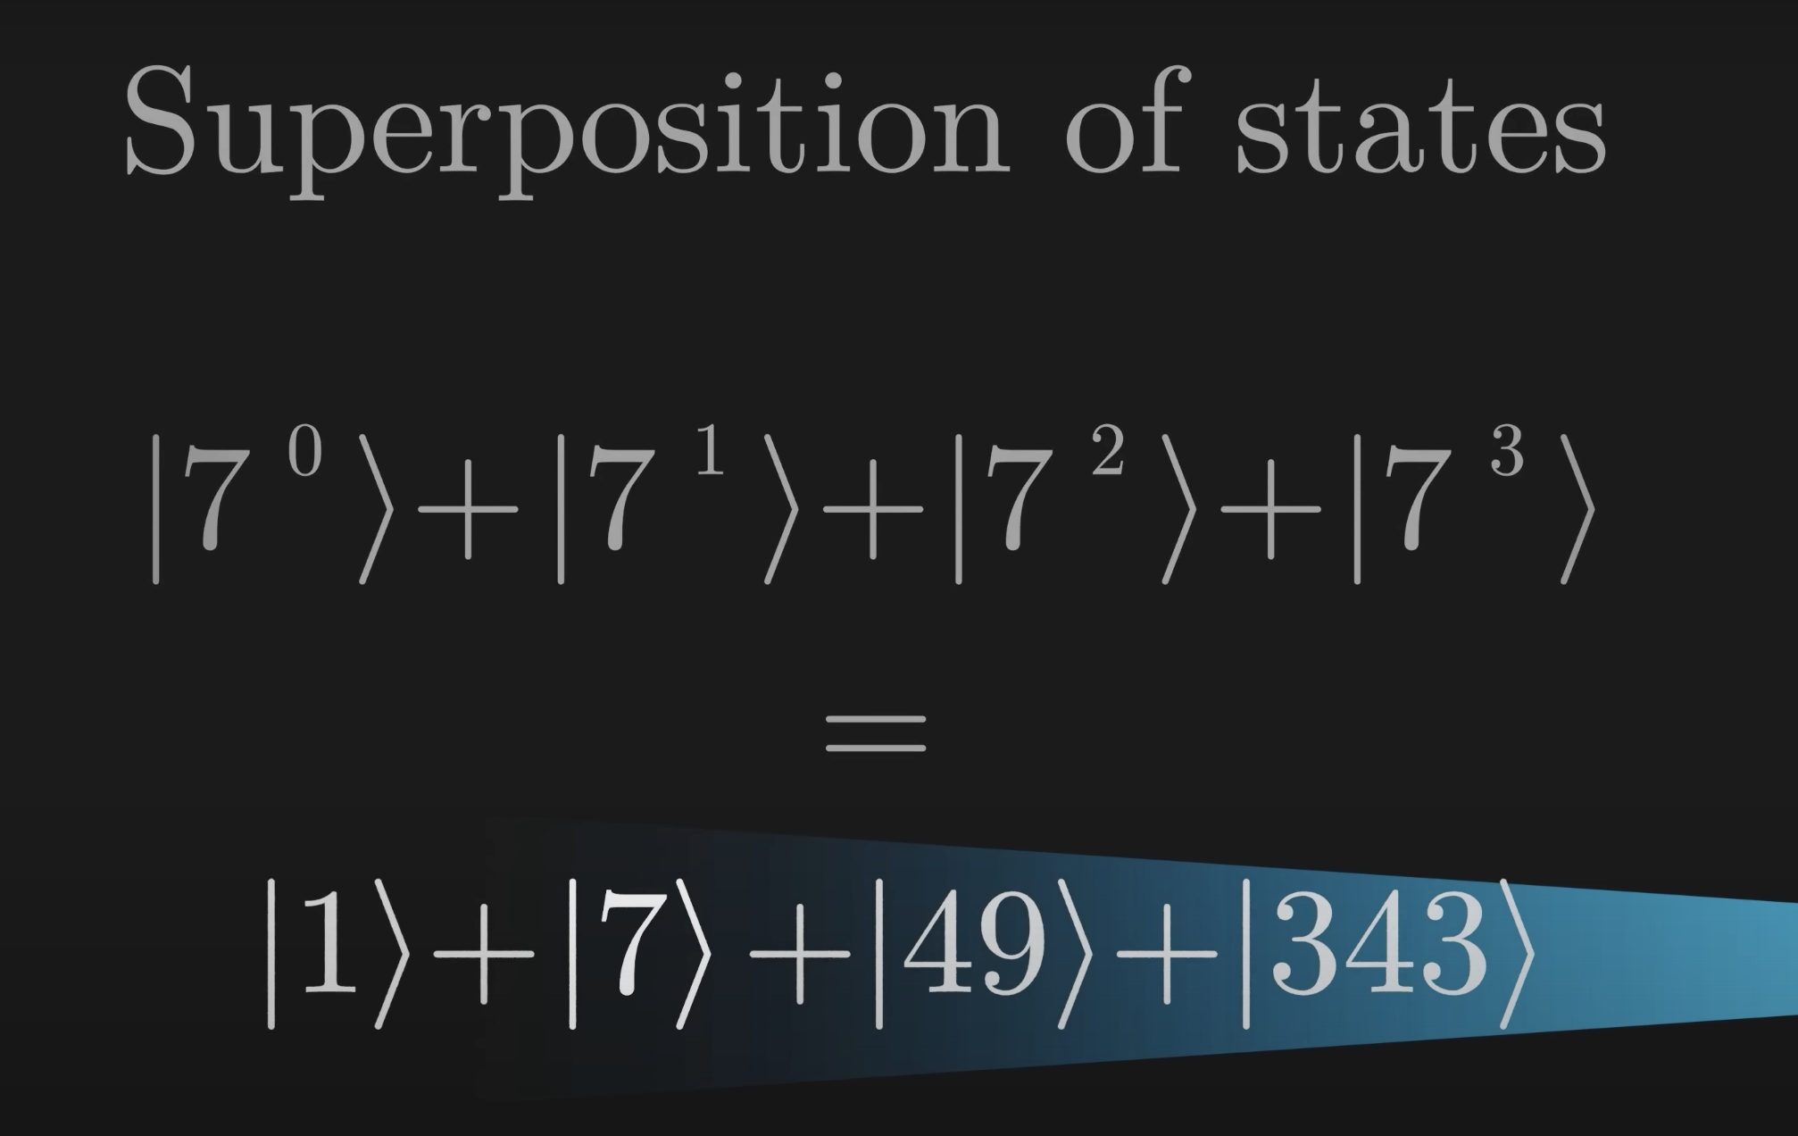
Measurement

Slide 16
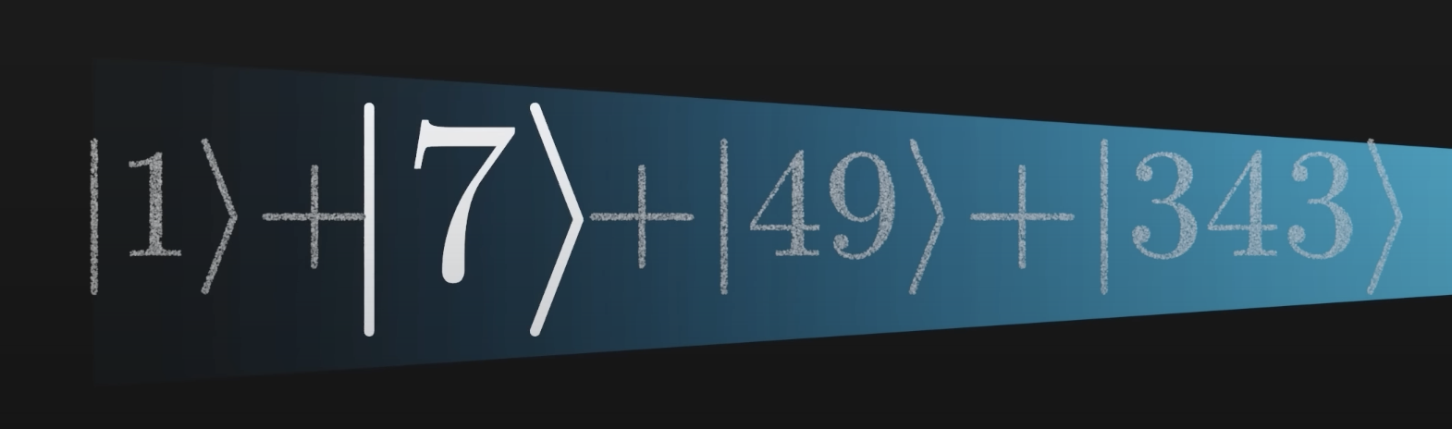
Measurement

Slide 17
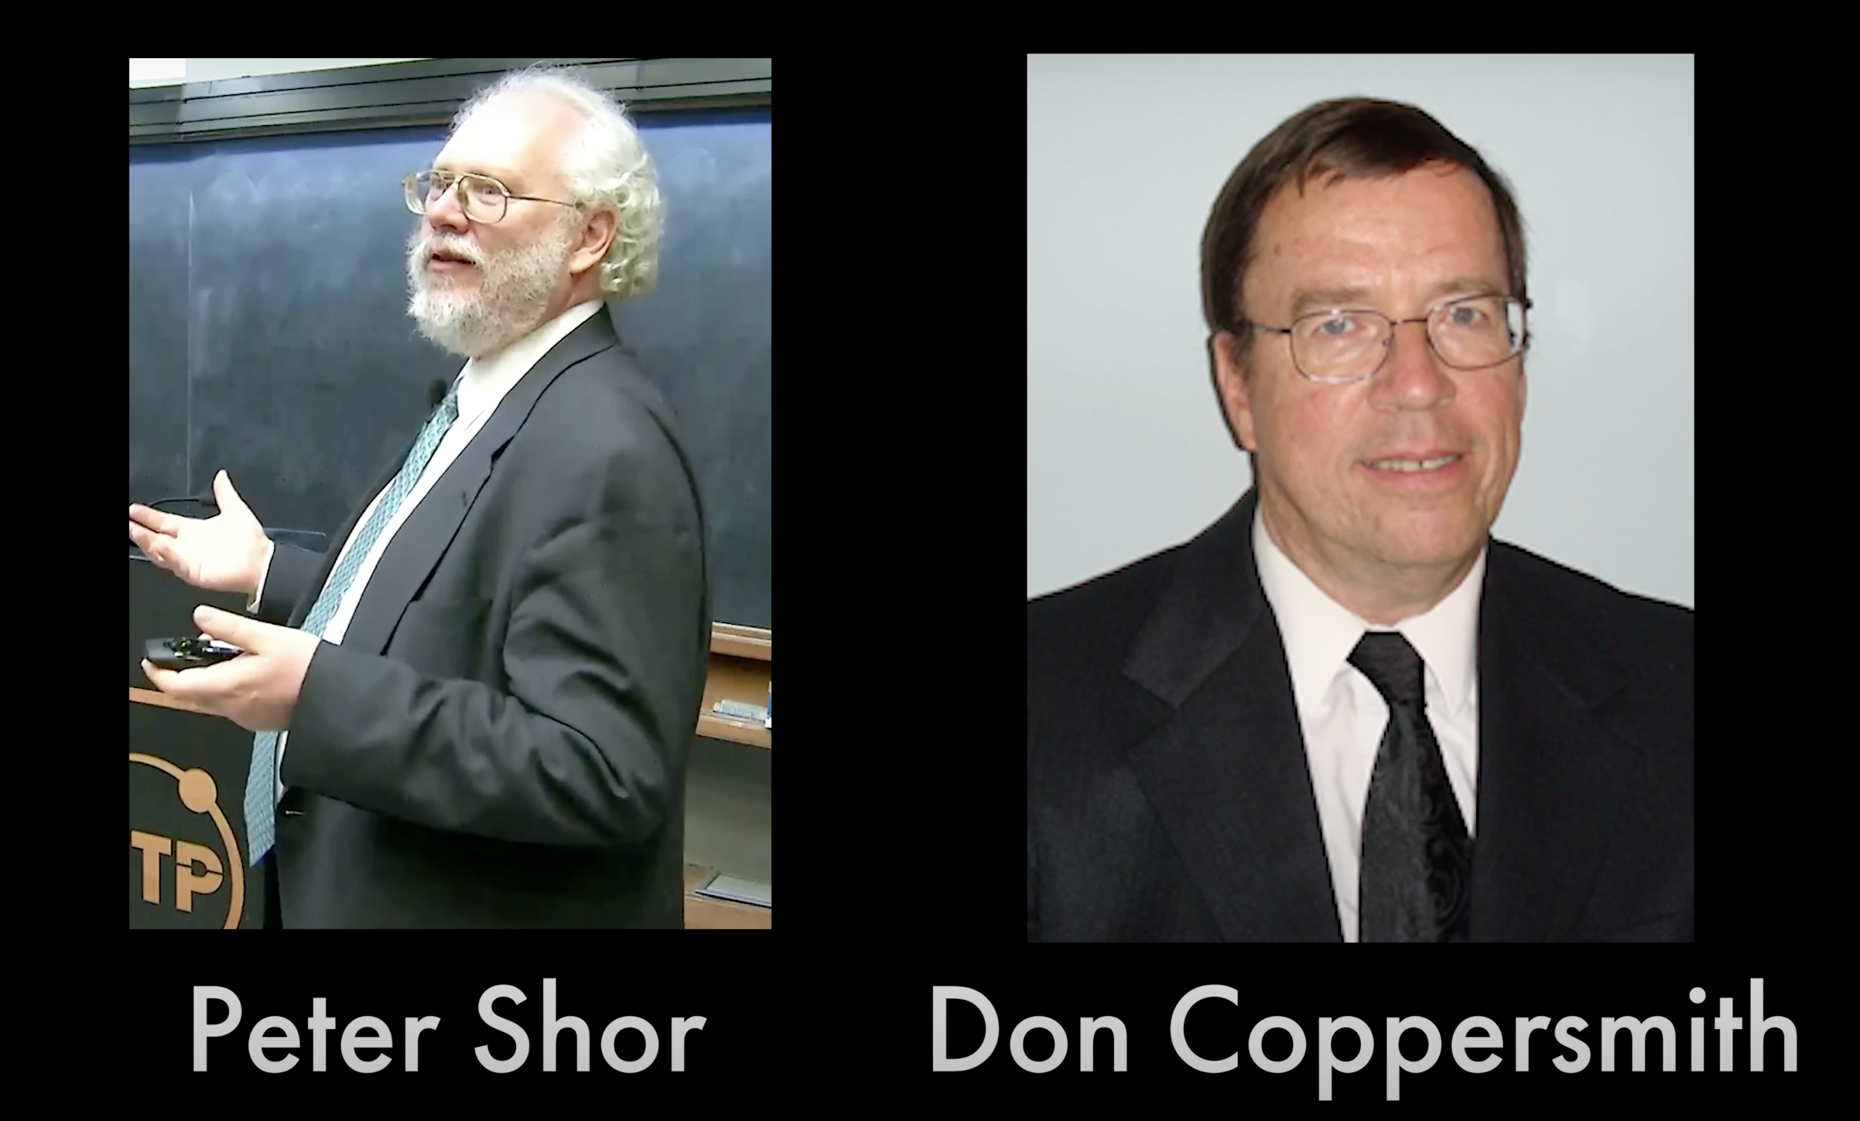
Shor’s Algorithm

Slide 18
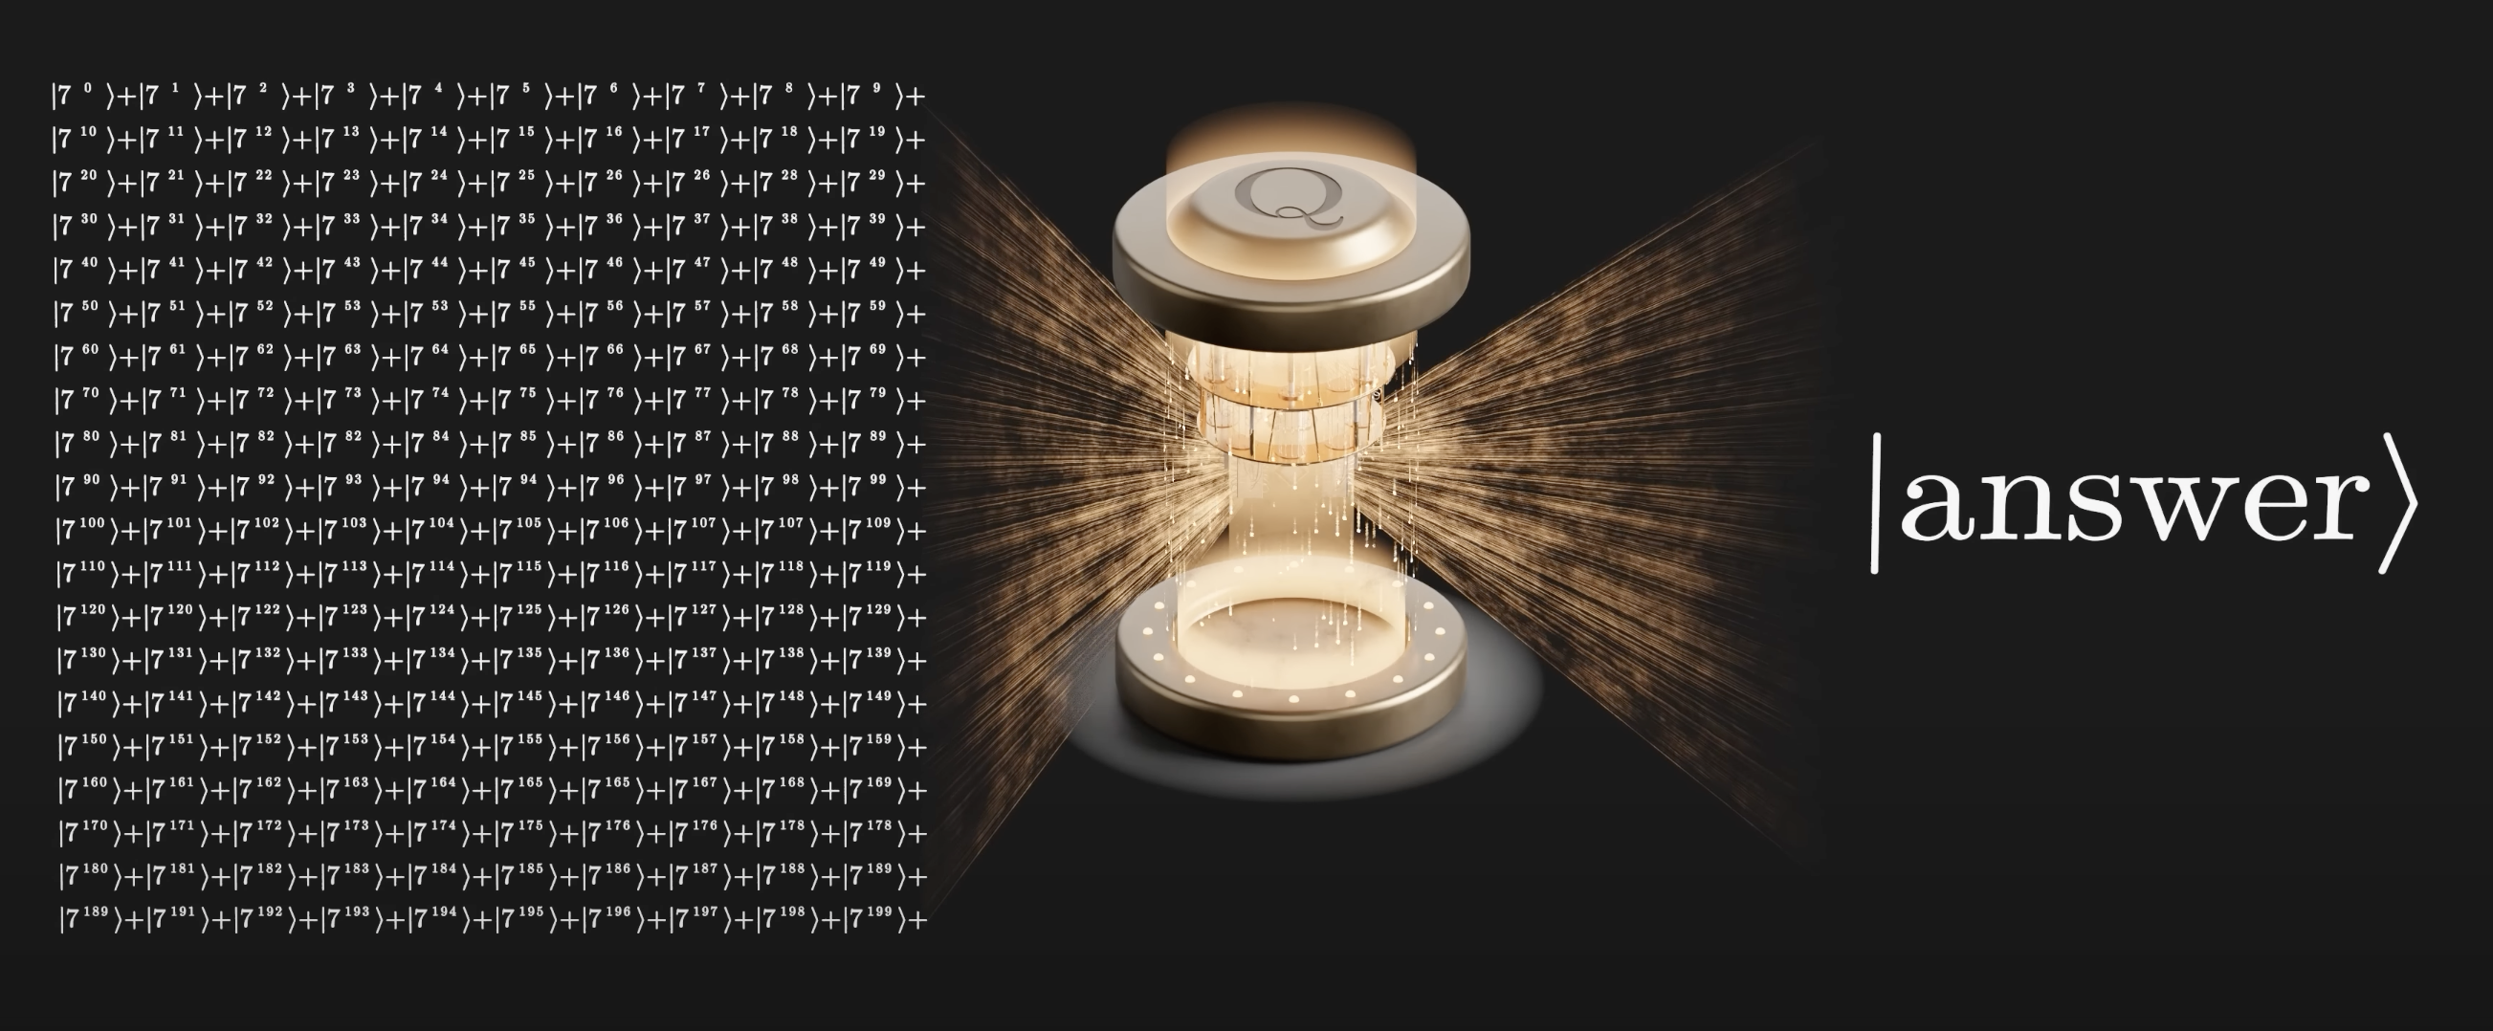
Shor’s Algorithm

Slide 19
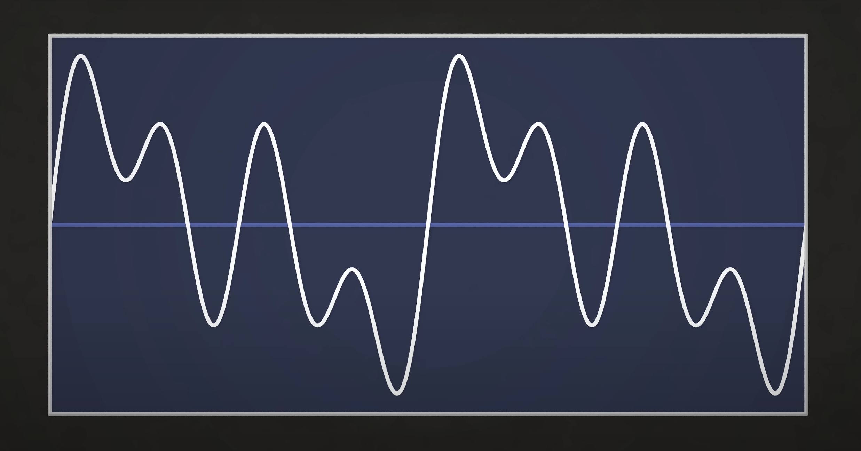
Fourier Transform

Slide 20
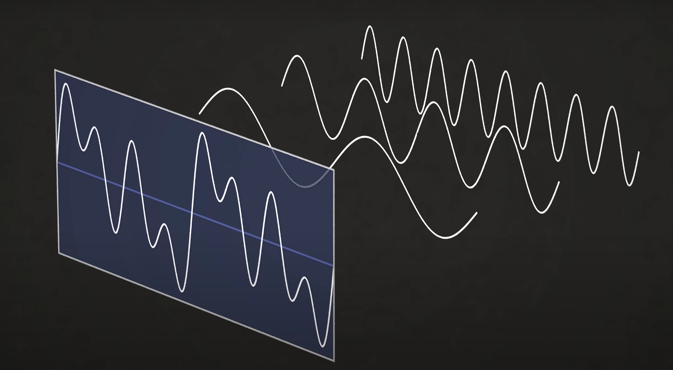
Fourier Transform

Slide 21
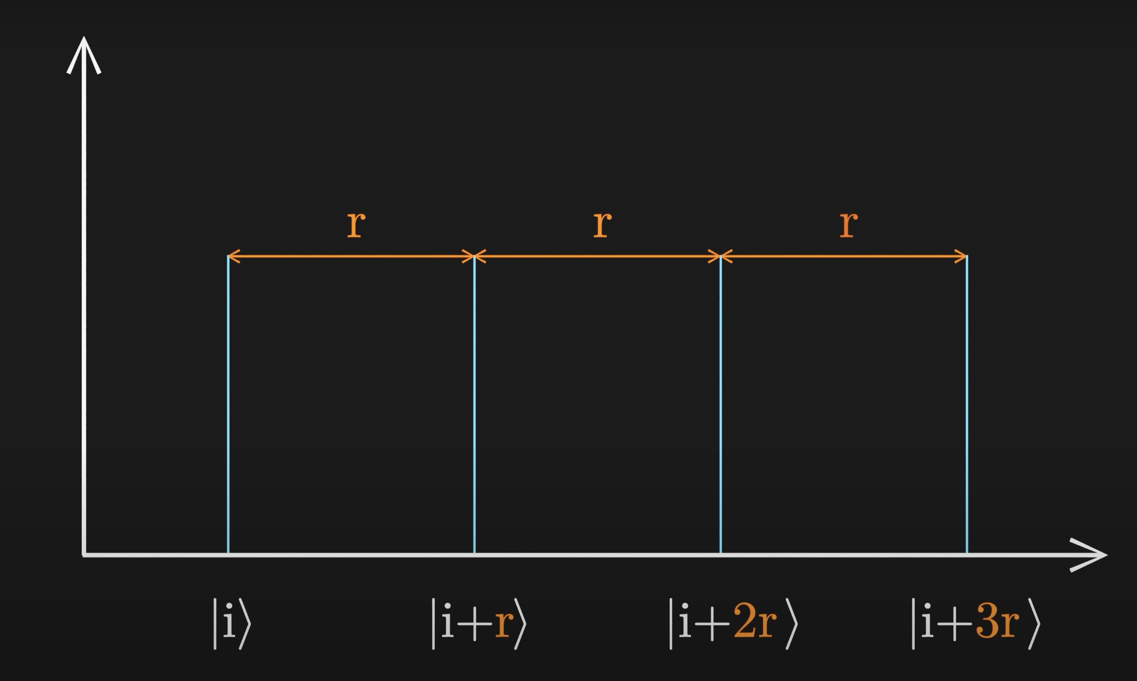
Quantum Fourier Transform

Slide 22
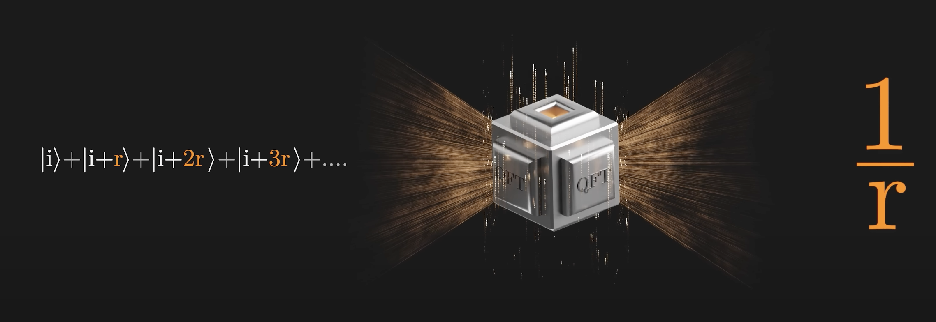
Quantum Fourier Transform

Slide 23
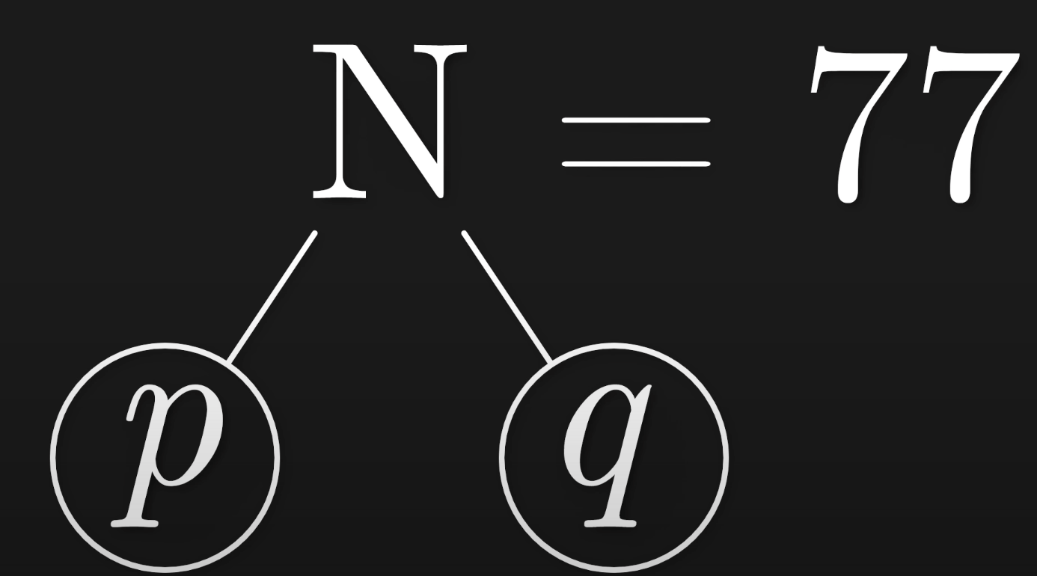
General Number Field Sieve

Slide 24
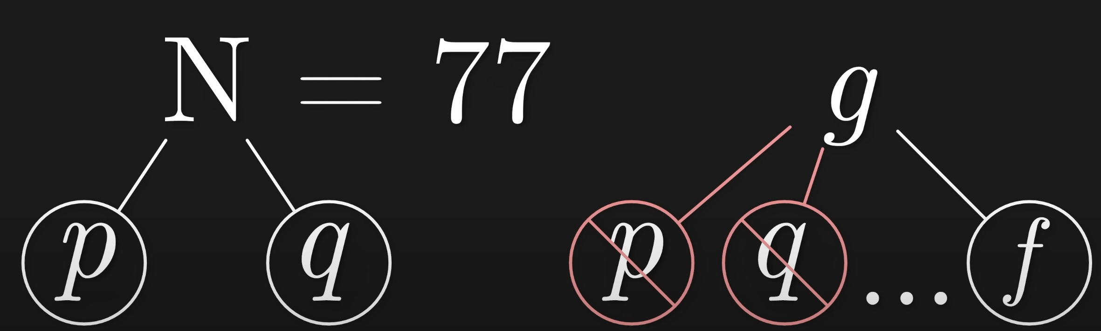
General Number Field Sieve

Slide 25
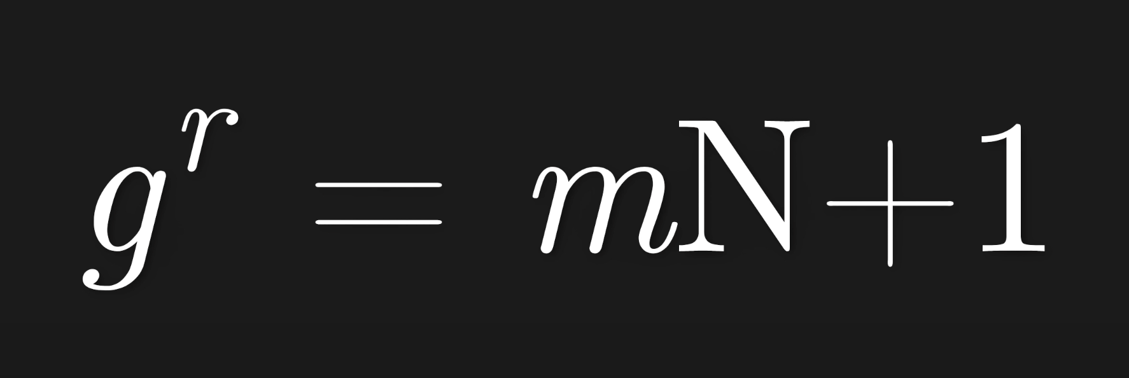
General Number Field Sieve

Slide 26
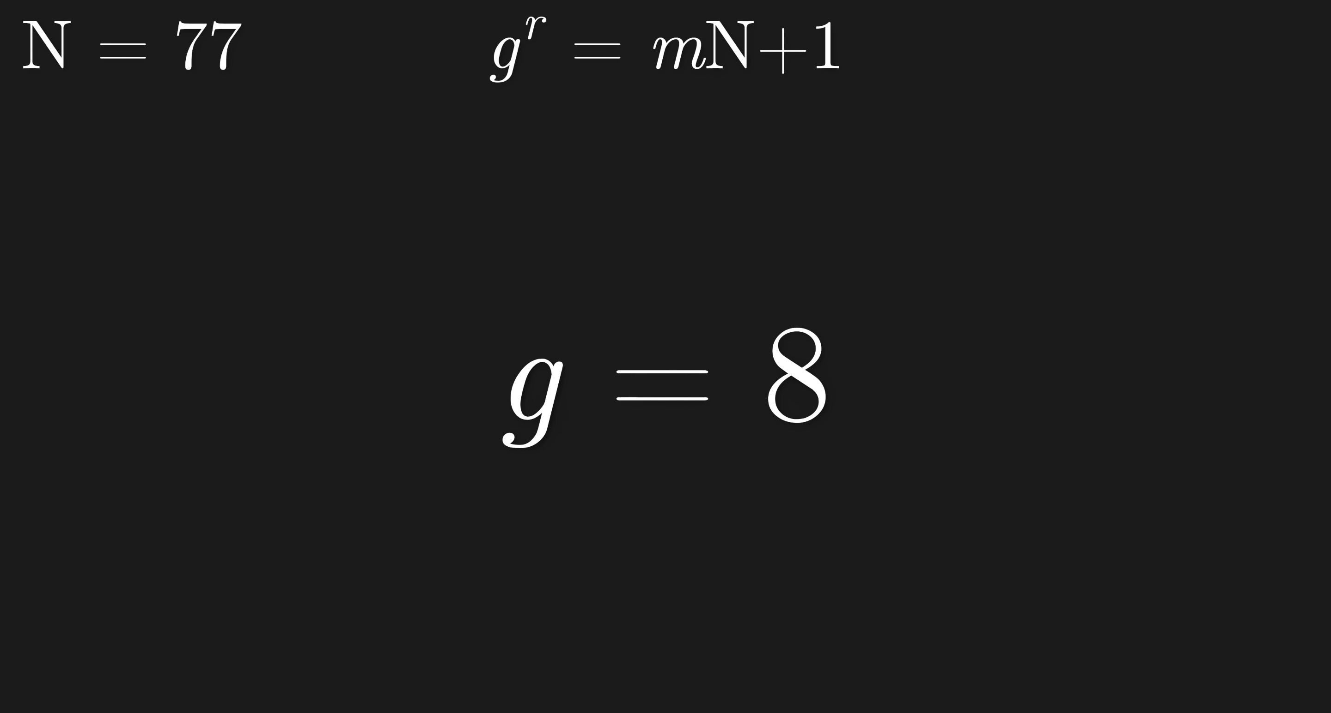
General Number Field Sieve

Slide 27
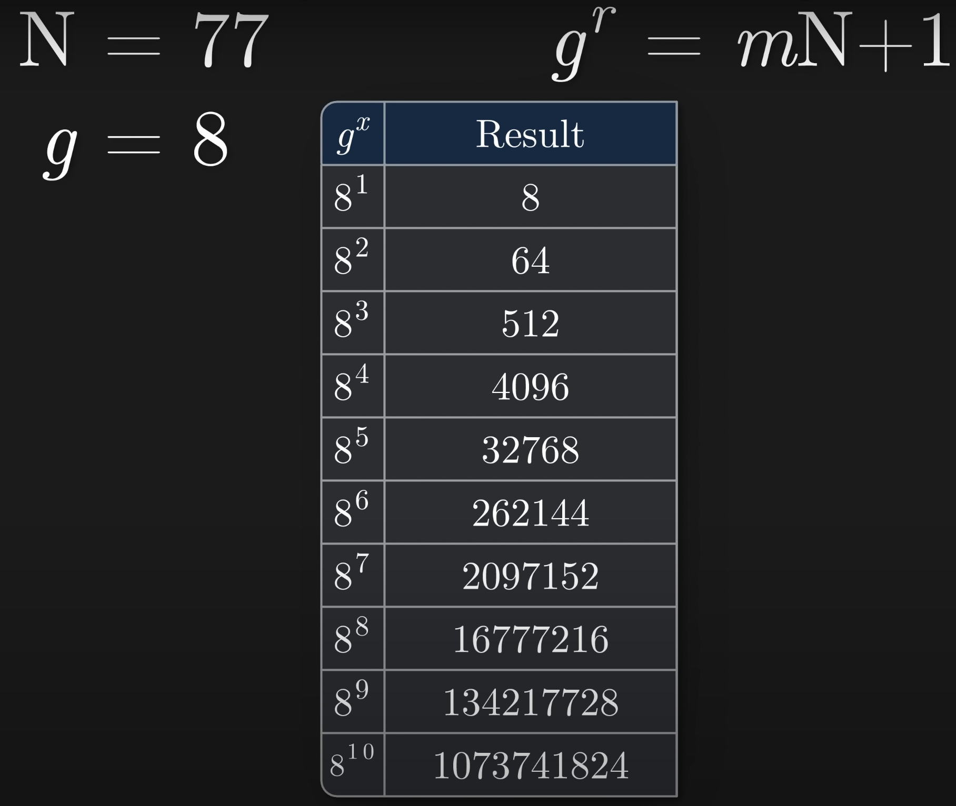
General Number Field Sieve

Slide 28
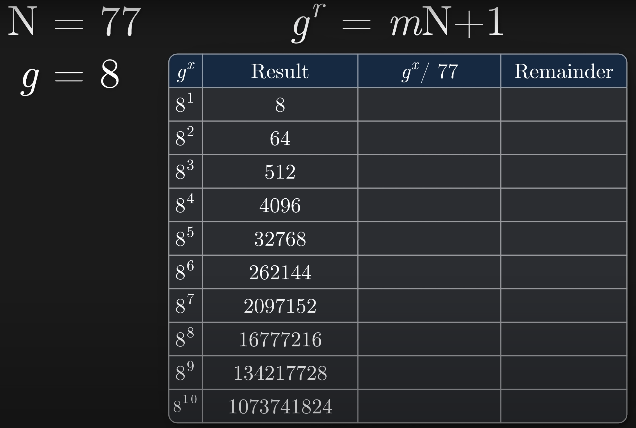
General Number Field Sieve

Slide 29
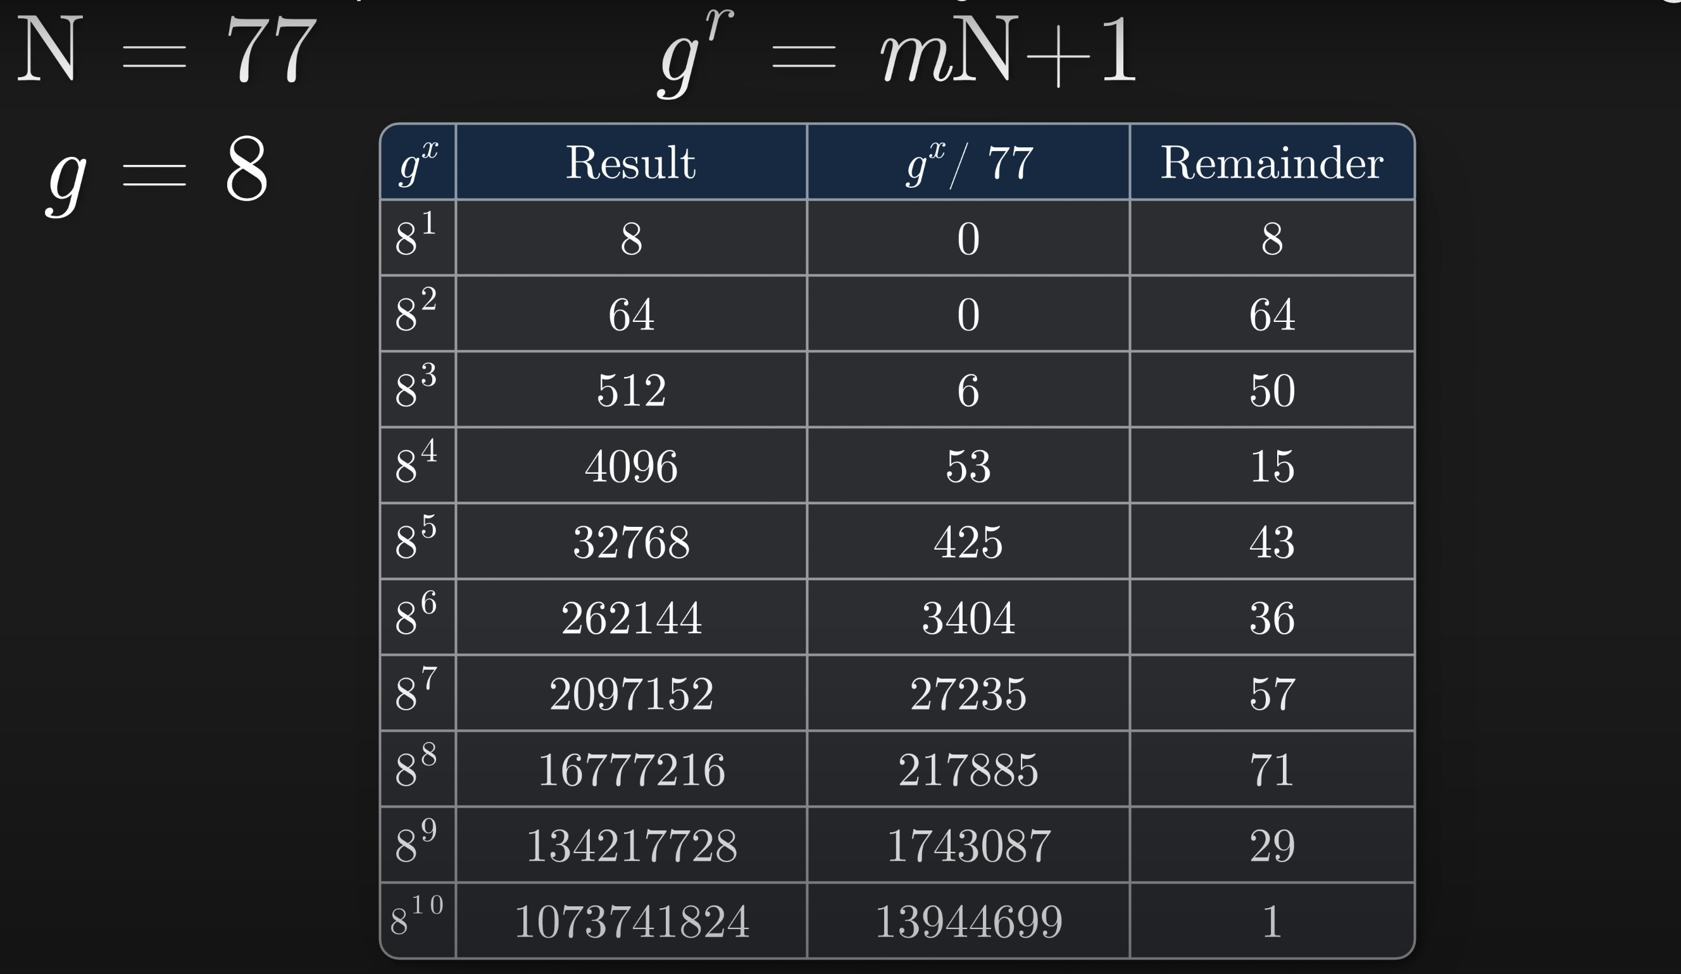
General Number Field Sieve

Slide 30
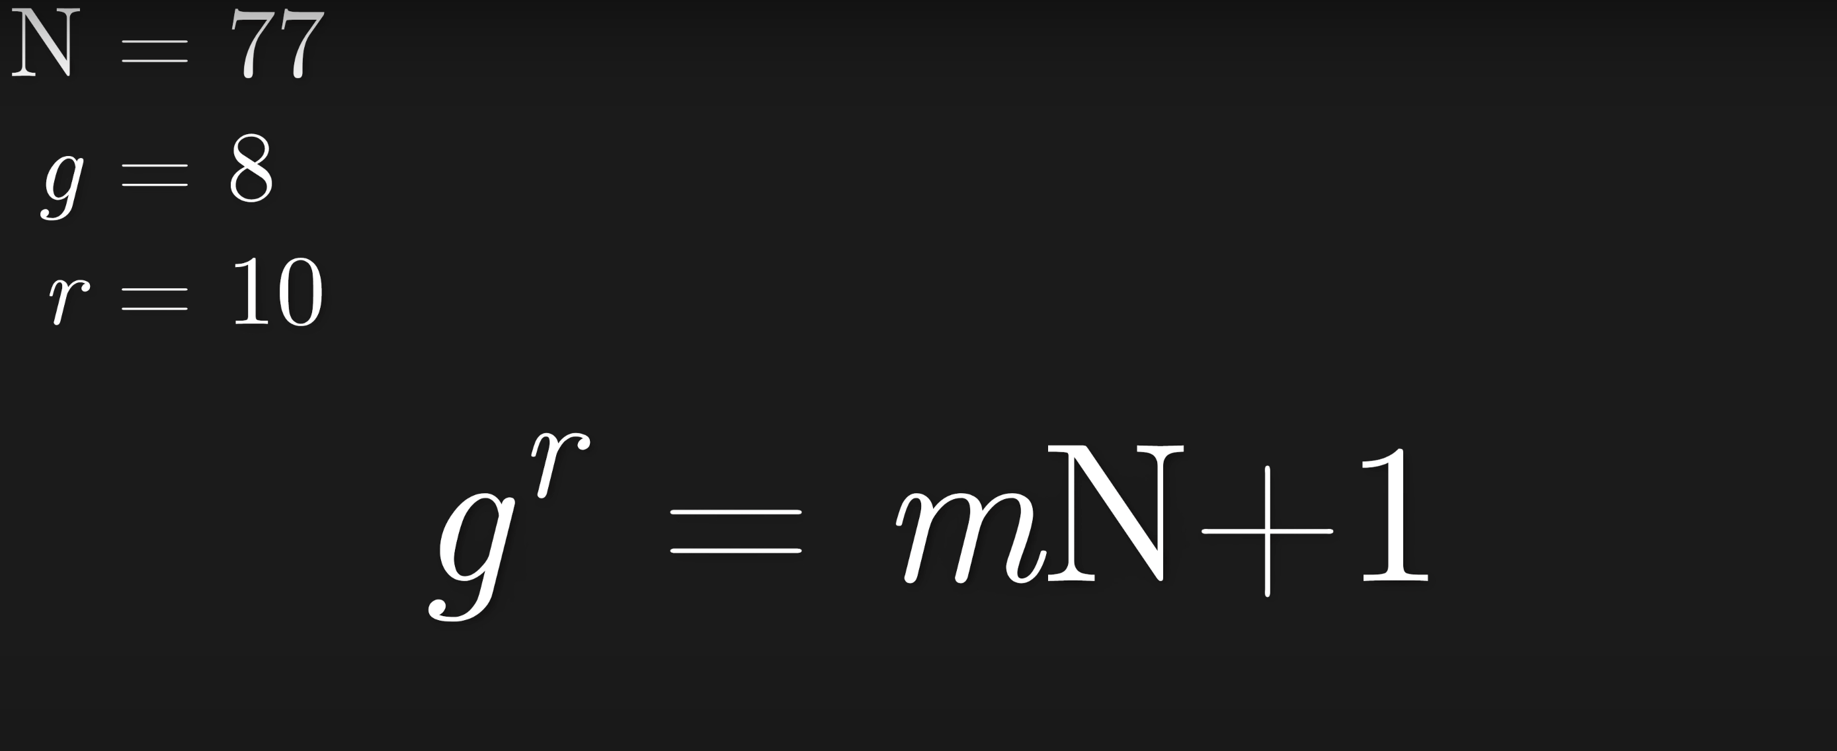
General Number Field Sieve

Slide 31
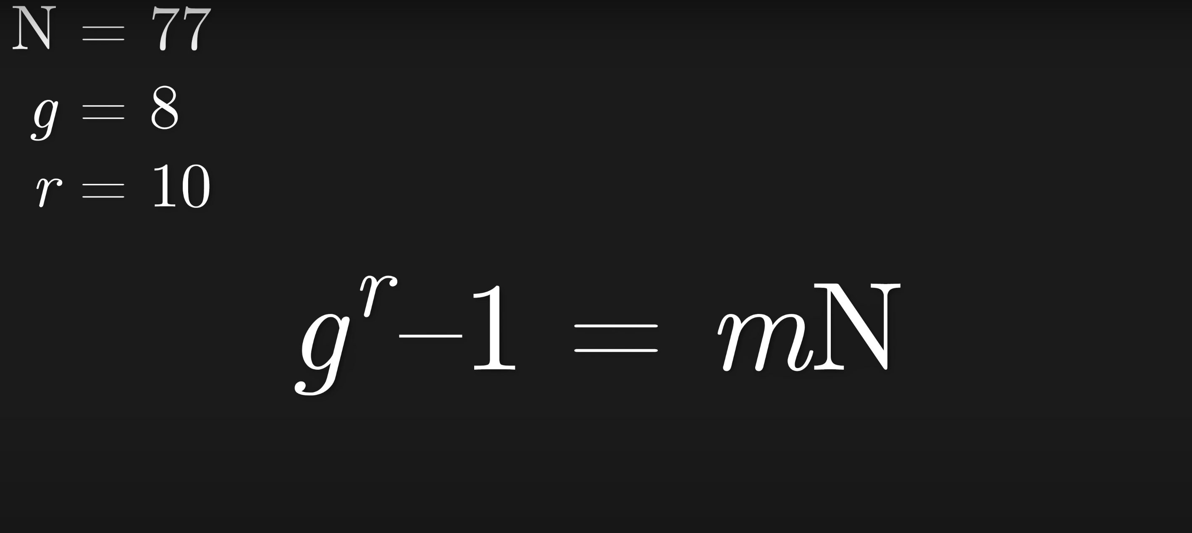
General Number Field Sieve

Slide 32
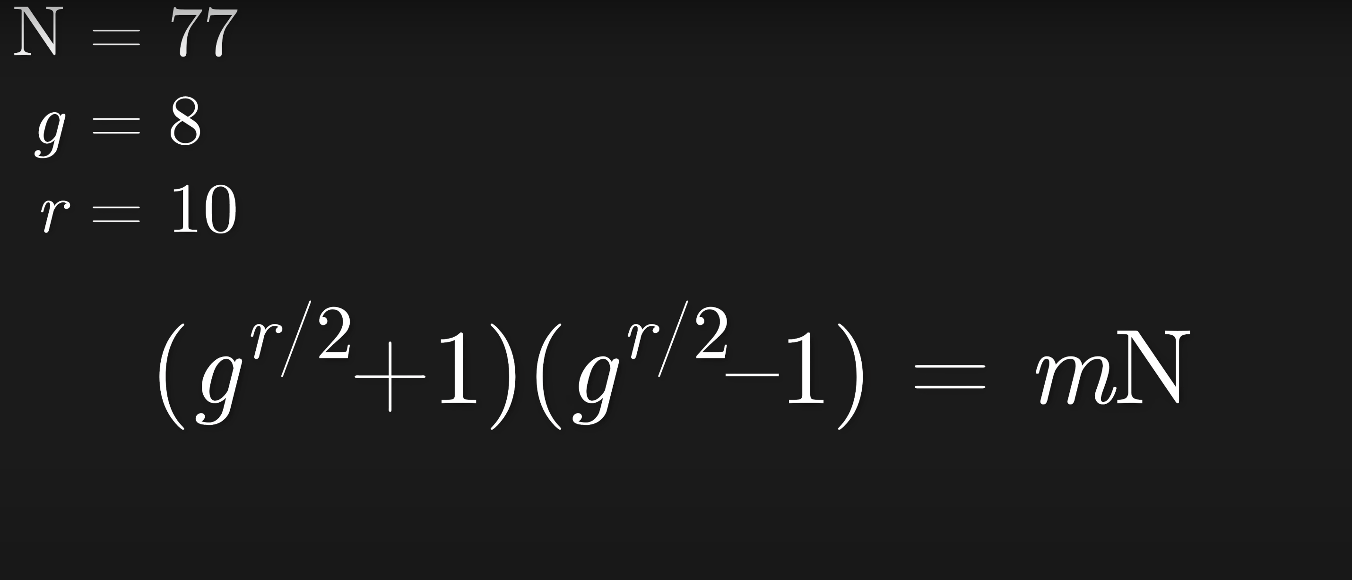
General Number Field Sieve

Slide 33
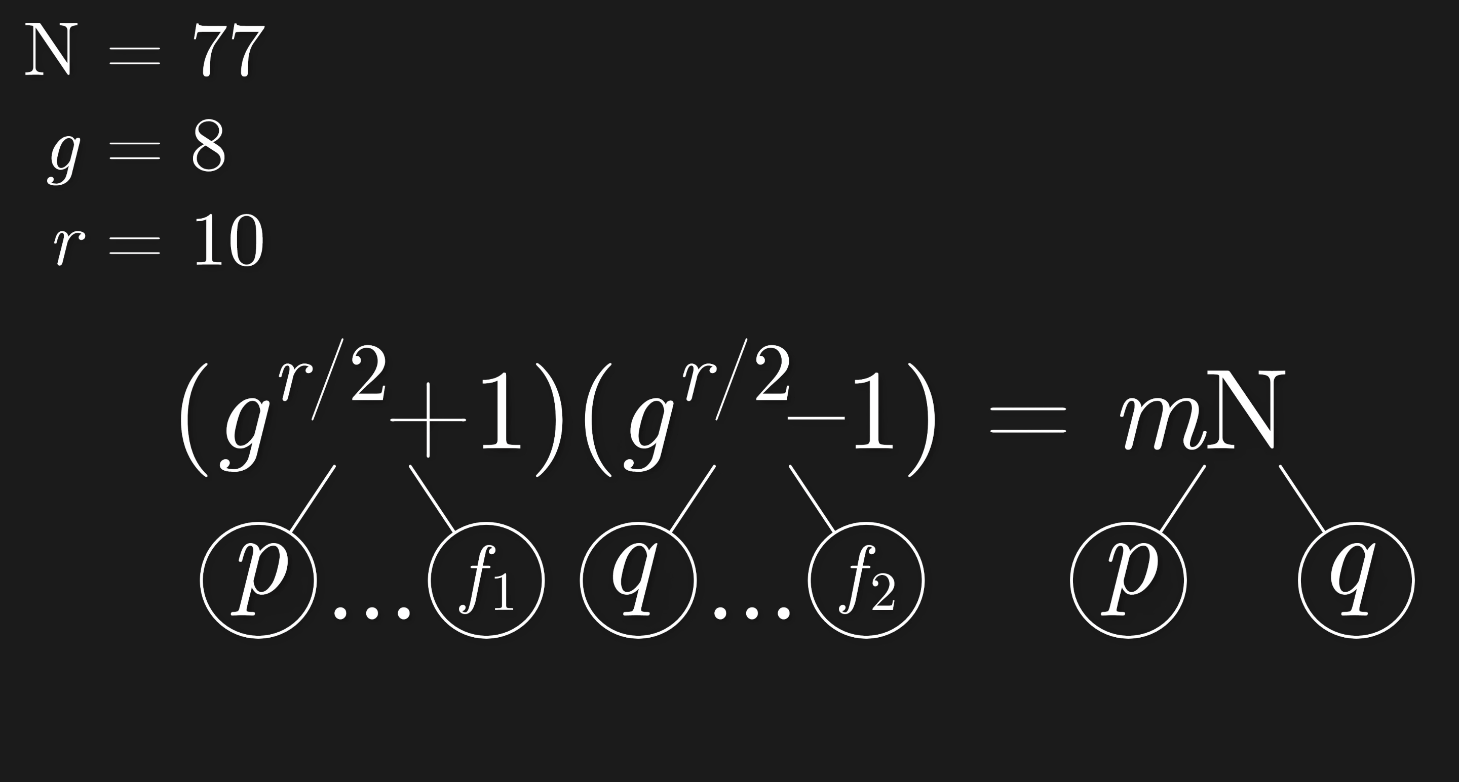
General Number Field Sieve

Slide 34
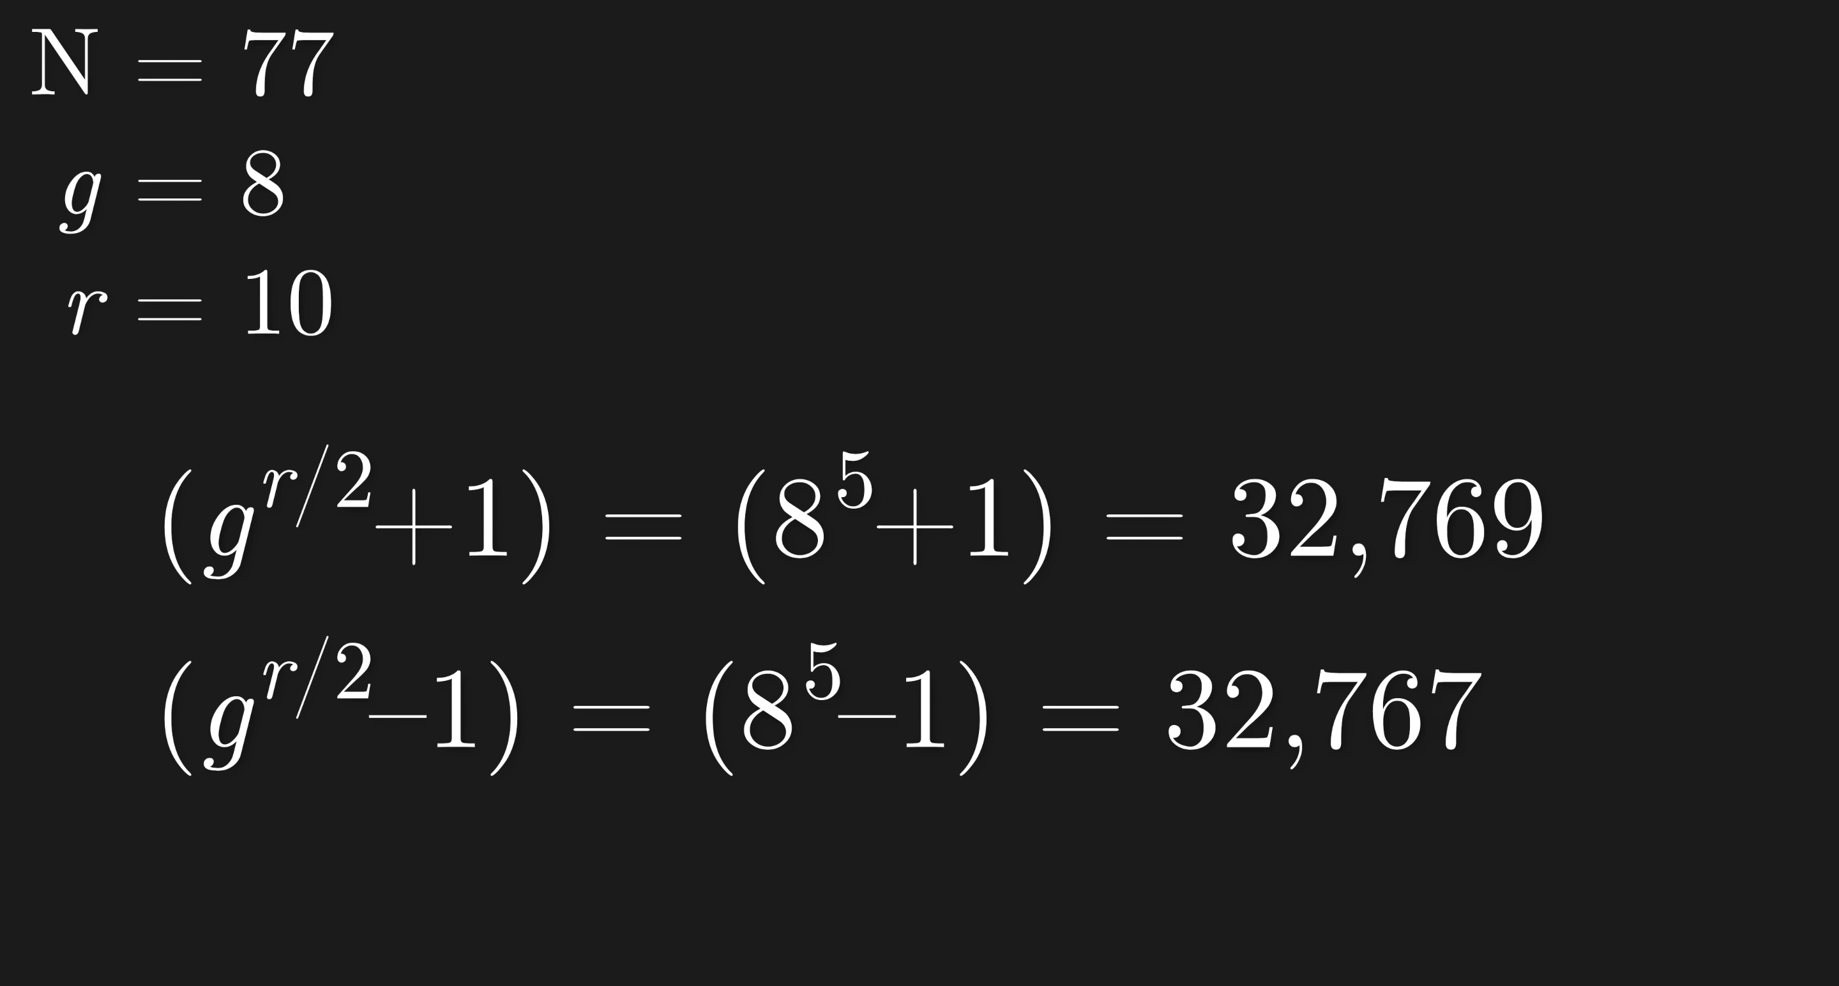
General Number Field Sieve

Slide 35
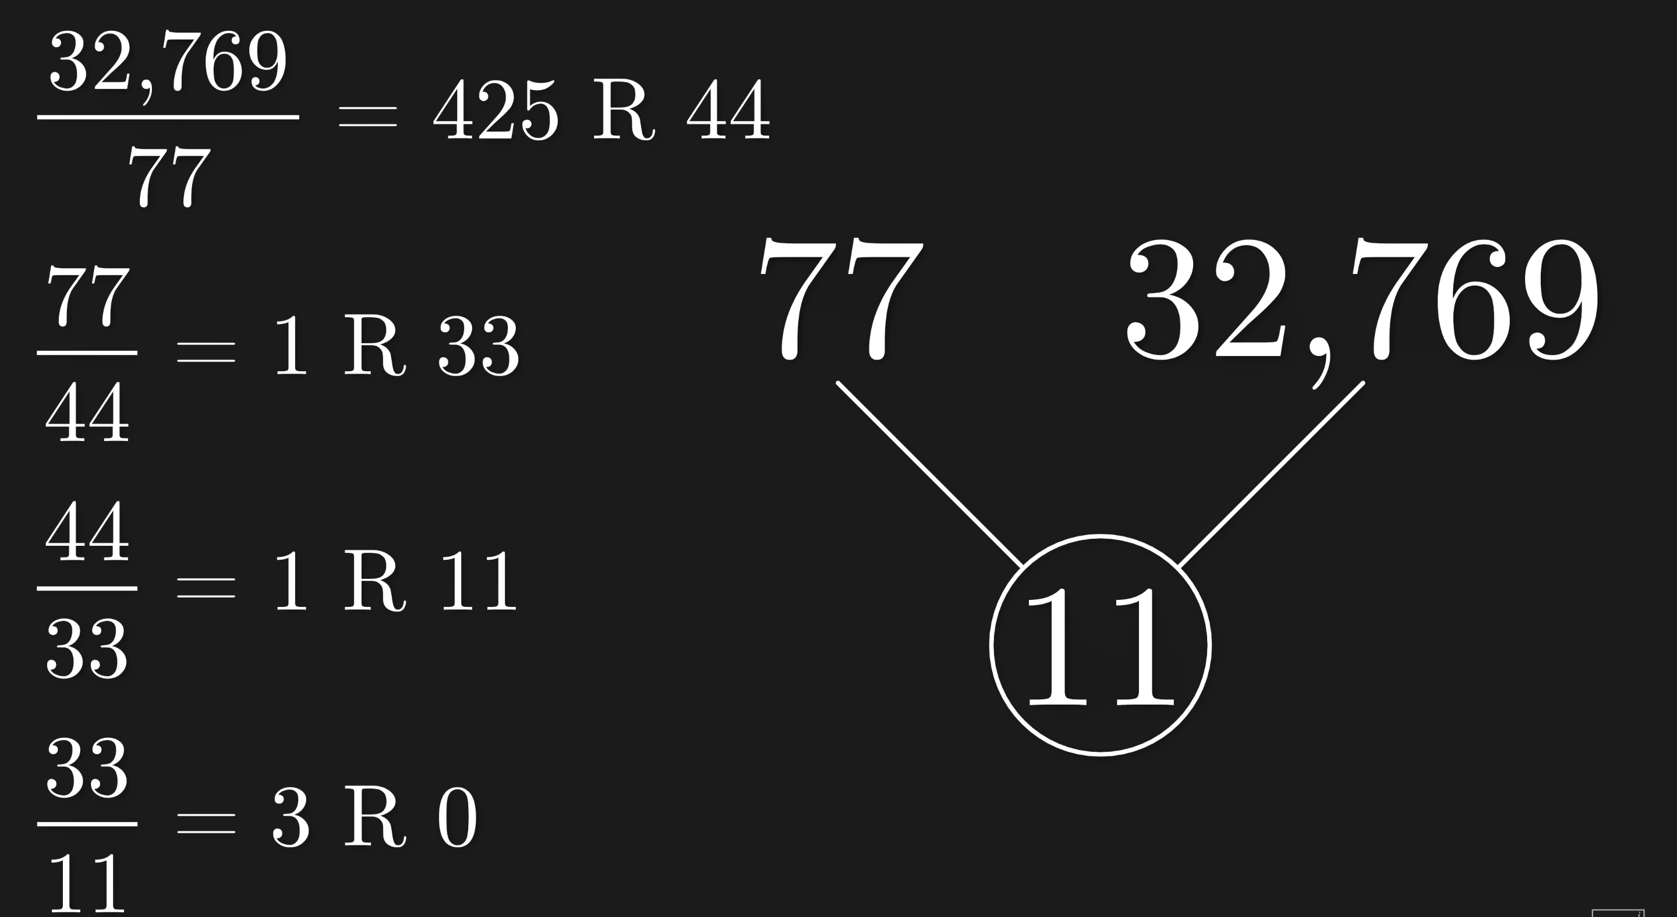
General Number Field Sieve

Slide 36
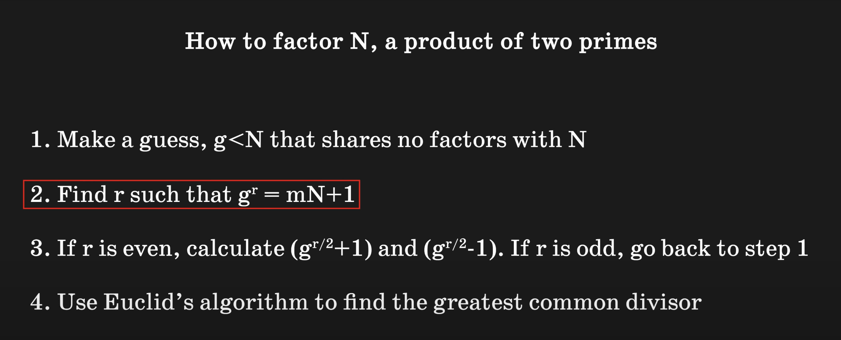
General Number Field Sieve

Slide 37
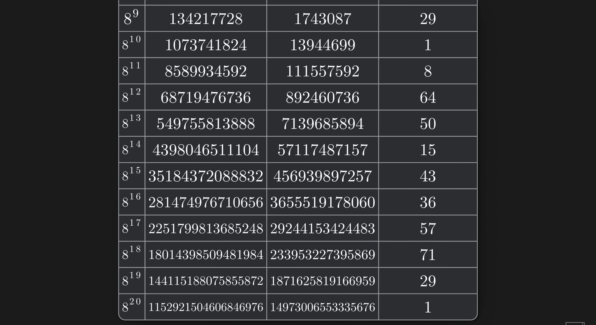
General Number Field Sieve

Slide 38
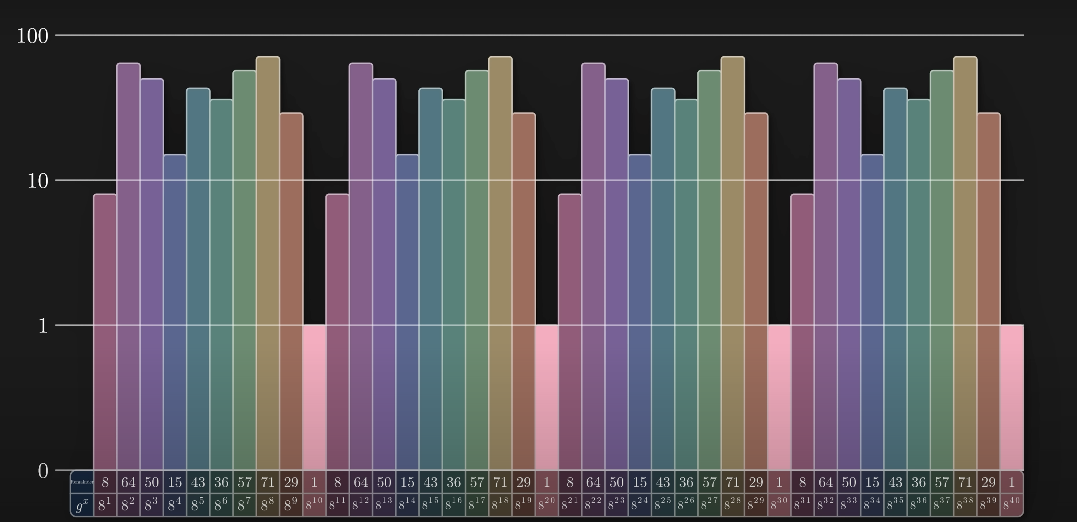
General Number Field Sieve

Slide 39
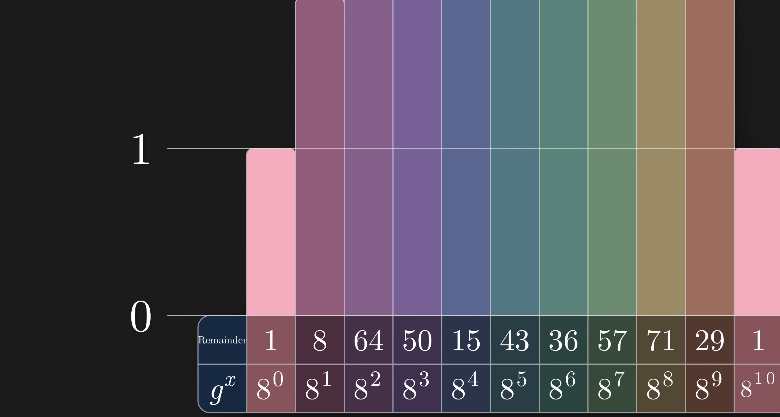
General Number Field Sieve

Slide 40
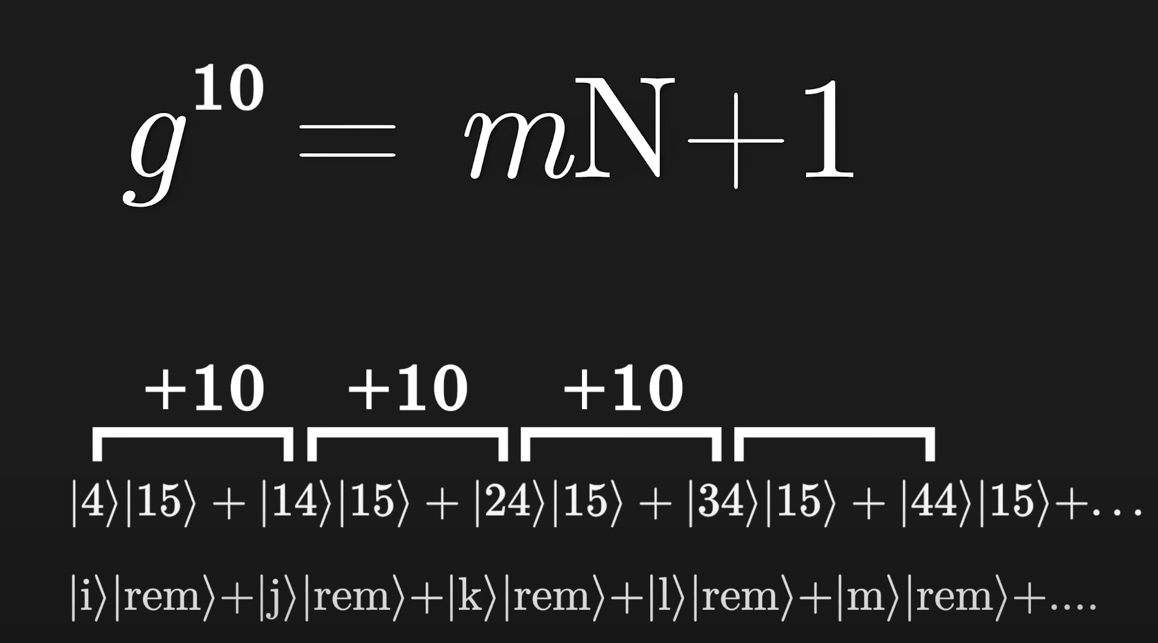
Solution

Slide 41
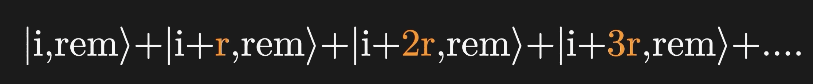
Solution

Slide 42
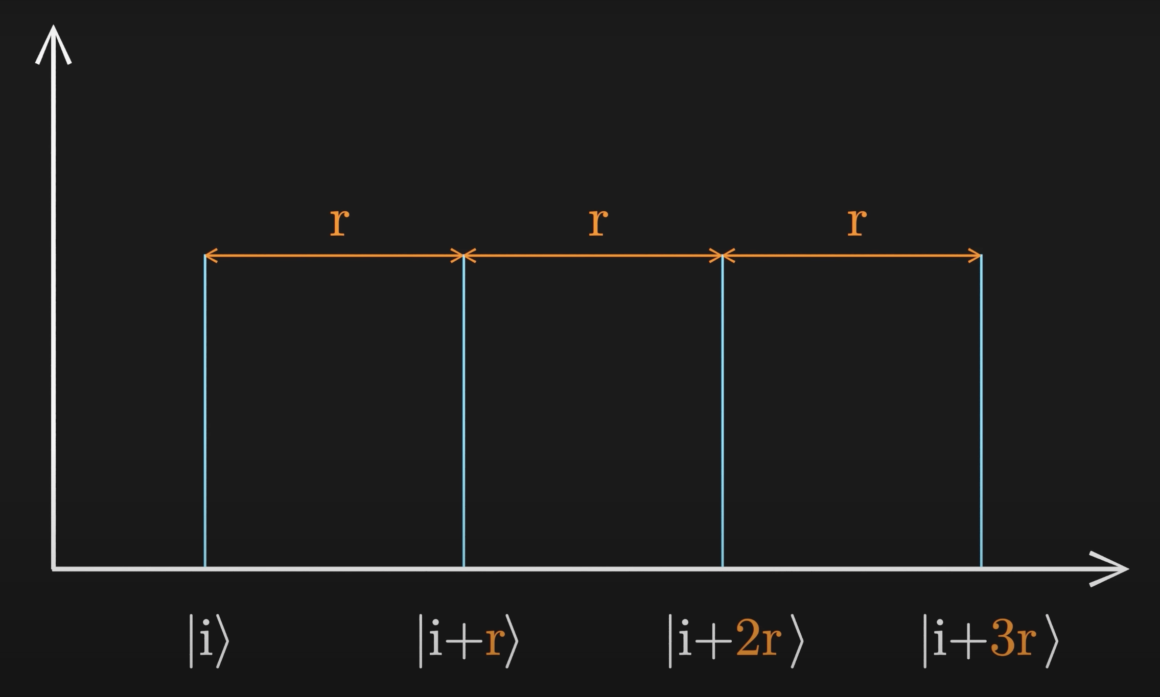
Solution

Slide 43
Quantum Fourier Transform

Slide 44
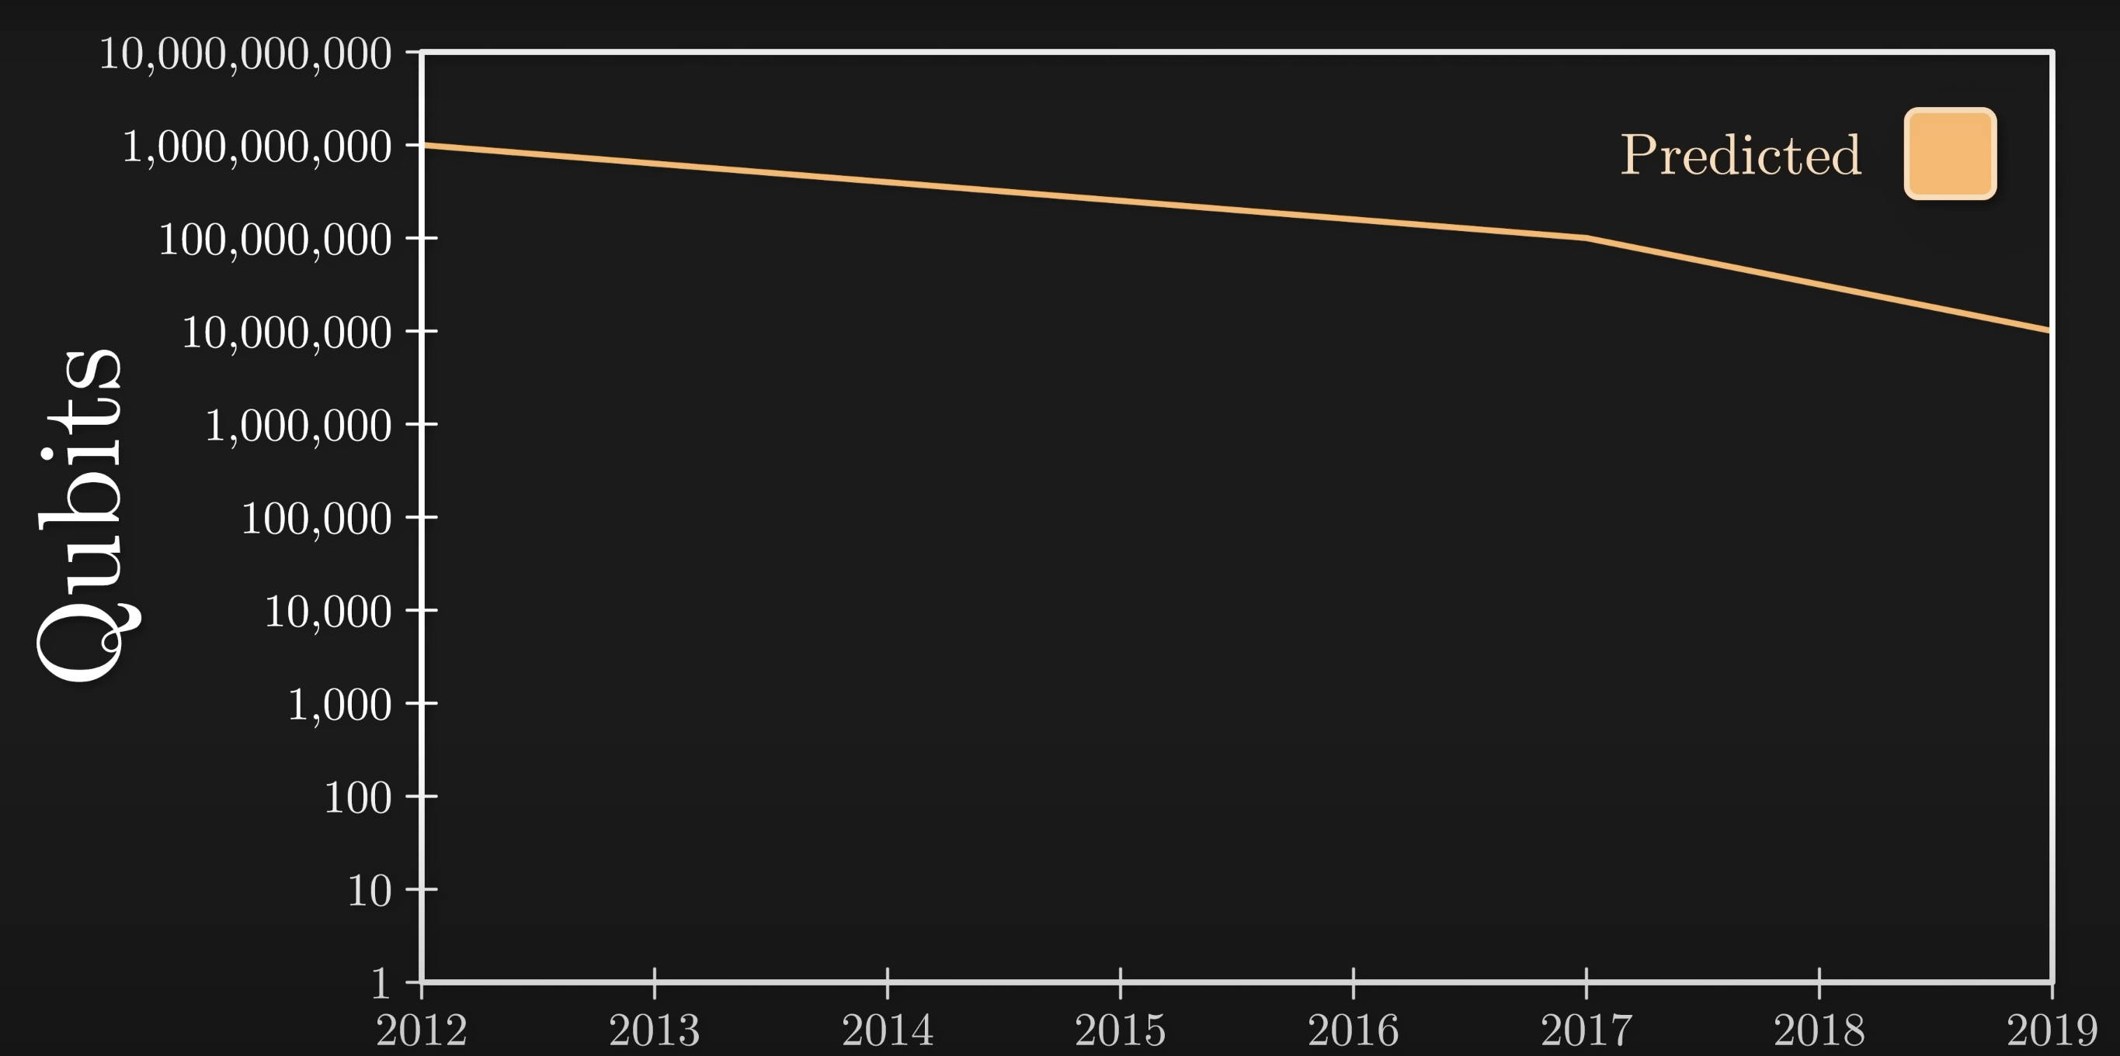
Decryption

Slide 45
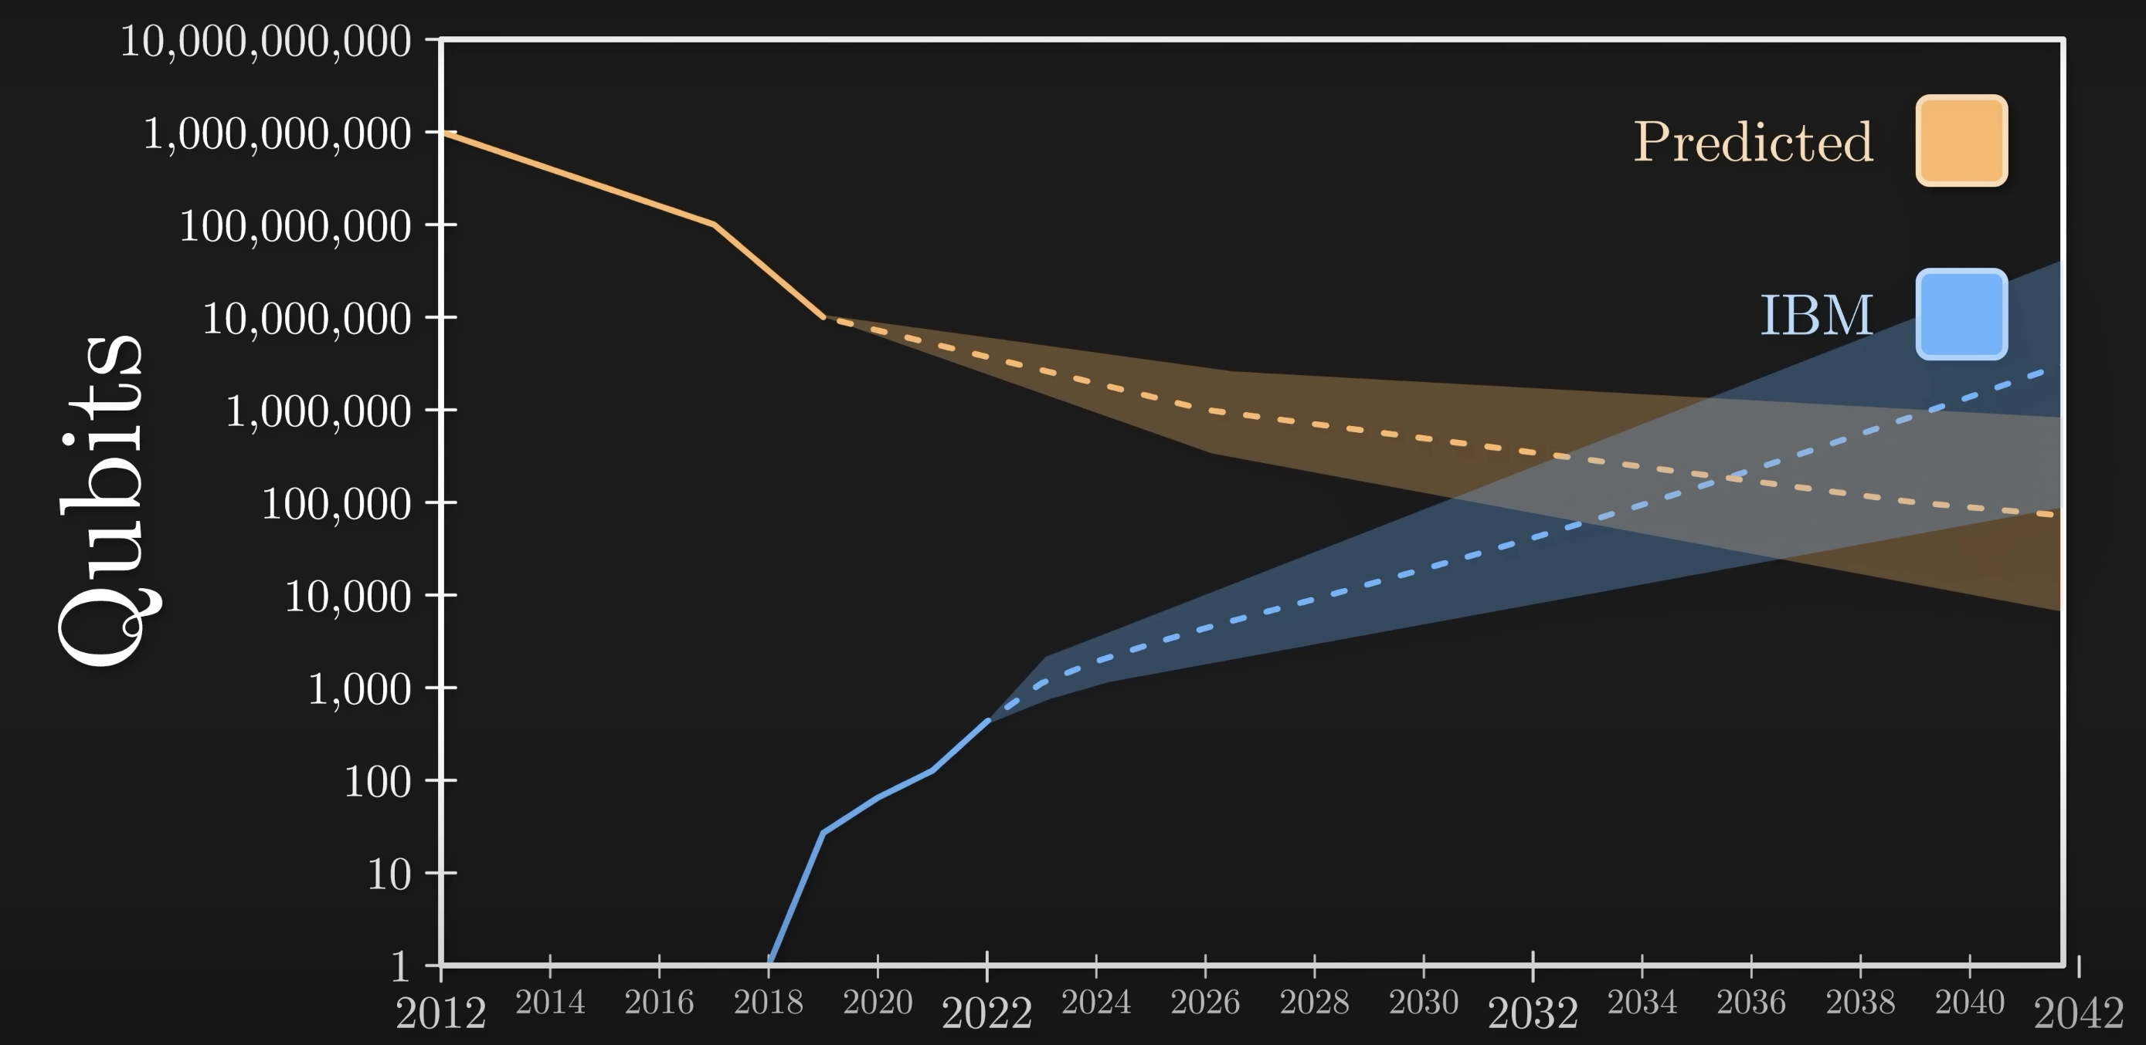
Decryption

Slide 46
Quantum-Proofing
National Institute of Standards and Technology (NIST) launches Quantum Safe Algorithms Cryptography Showdown in 2016
82 Submissions Received
Results Announced in 2022
4 Tentatively Accepted
Of which 3 are lattice-based

Slide 47
Quantum-Proofing Algorithms
General Purpose
CRYSTALS-Kyber
Digital Signatures
CRYSTALS-Dilithium
FALCON
SPHINCS+

Slide 48
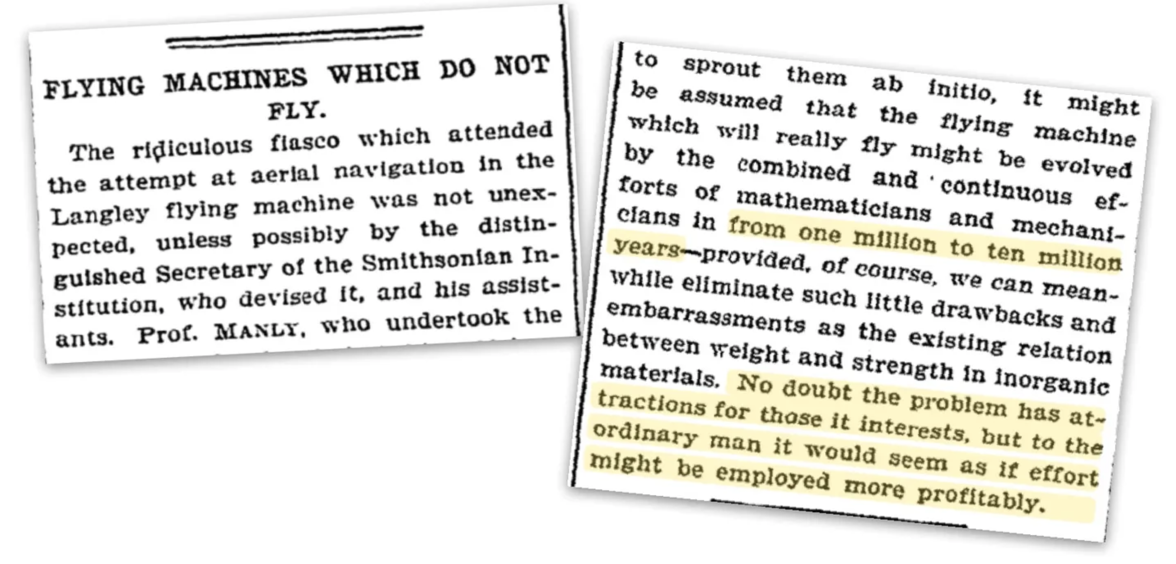
Conclusion

Slide 49
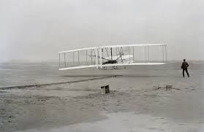
Conclusion

Slide 50
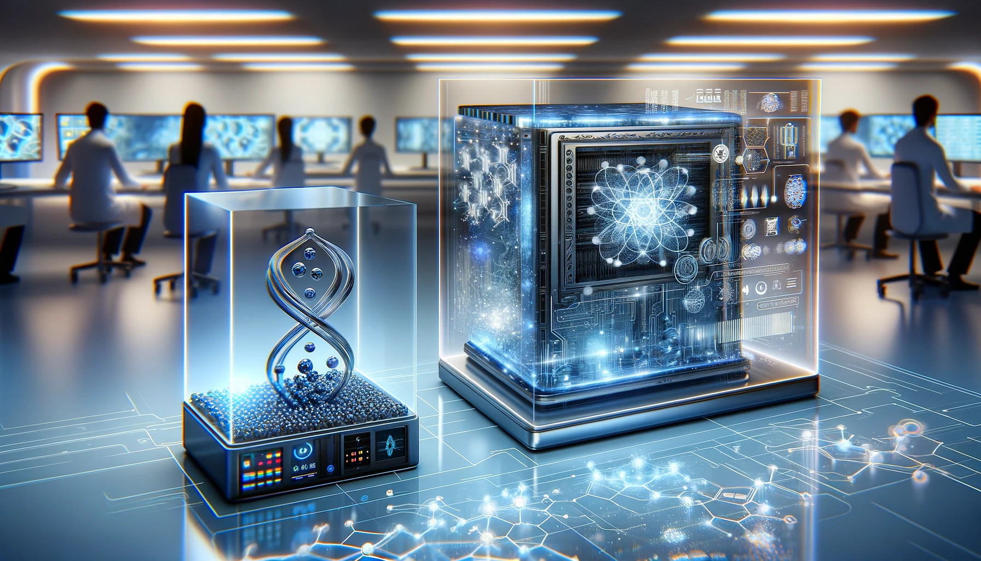
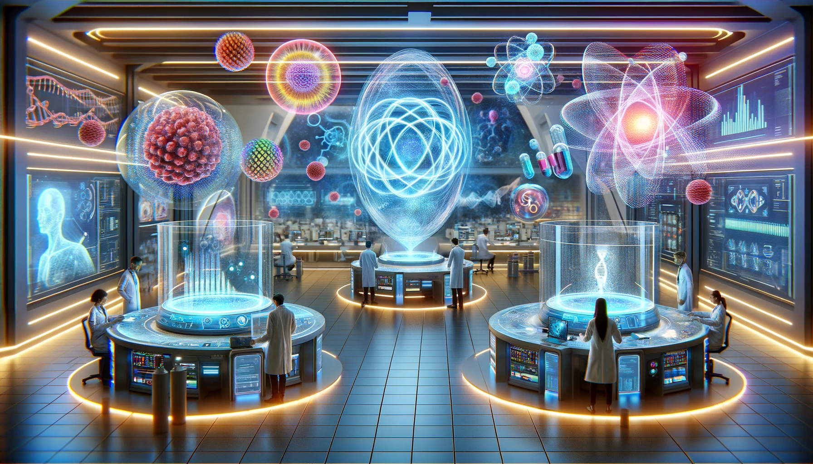
Future of Quantum Computing

Slide 51
References
Montanaro, A., & Pallister, S. (2020). "Quantum Algorithms: An Overview." npj Quantum Information, 6, 1-8.
Chen, L., et al. (2020). "Report on Post-Quantum Cryptography." US Department of Commerce, National Institute of Standards and Technology. https://csrc.nist.gov/publications/detail/nistir/8105/final
Gyongyosi, L., & Imre, S. (2020). "A Survey on Quantum Computing Technology." Computer Science Review, 36, 100246.
Roetteler, M., & Steinwandt, R. (2021). "Post-Quantum Cryptography: State of the Art." Journal of Cryptology, 34(1), 1-3.
How Quantum Computers Break The Internet… Starting Now Veritasium (2023). https://www.youtube.com/watch?v=-UrdExQW0cs

Slide 52
Thank You

